Slide 1
Introduction to Degree works
West Virginia University
Office of the University Registrar
v6.0 Spring 2016

Slide 2
Training Contents
Objectives
Background information on Degree Works
Degree Works and Banner
Accessing Degree Works
Searching for students
Block Explanations
Reading an audit
Additional Features
Class History
Subject History
Plans
Notes
GPA Calculator
What If
Possible Irregularities
v6.0 Spring 2016

Slide 3
Training Objectives
How to use criteria for identifying populations
Understand and interpret an audit
Understand how the University Catalogs and Degree Works are tied together
Utilize additional audit and student analytic tools
v6.0 Spring 2016

Slide 4
What is Degree Works?
A web based tool that will provide a clear and convenient method for students and advisors to track degree progress, prepare for registration, and plan for graduation
Degree Works is designed to aid and facilitate academic advising and degree completion
Degree Works is used by undergraduate, graduate, and professional students for graduation certification. All undergraduates must have a complete degree works audit in order to graduate.
v6.0 Spring 2016

Slide 5
Who Can use degree works?
All currently enrolled students can access Degree Works through MIX
All WVU personnel who are listed as Advisor in Banner have access to Degree Works.
Please visit http://registrar.wvu.edu/forms to access the Advisor Information form if you need access to Degree Works and currently do not
v6.0 Spring 2016

Slide 6
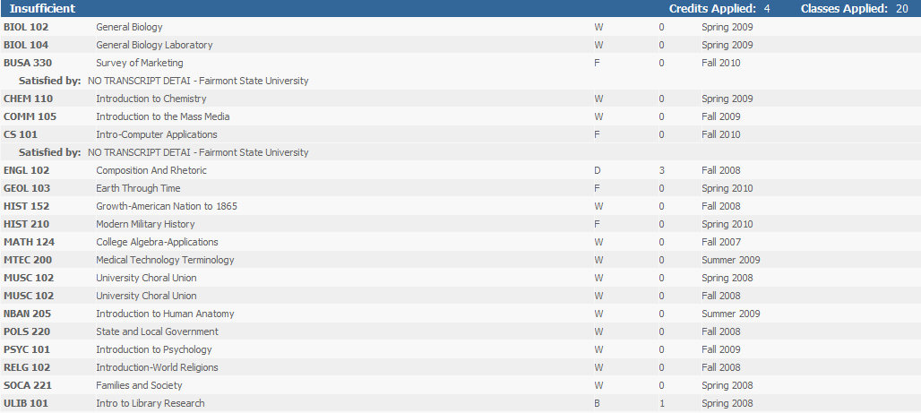
Degree Works and BAnner
Degree Works gets all of its student information directly from Banner.
Catalog/ Academic Year
Academic Program
GPA
Classification
WVU/Transfer coursework
Advisor
Holds
v5.0 Fall 2014
v5.0 Fall 2014

Slide 7
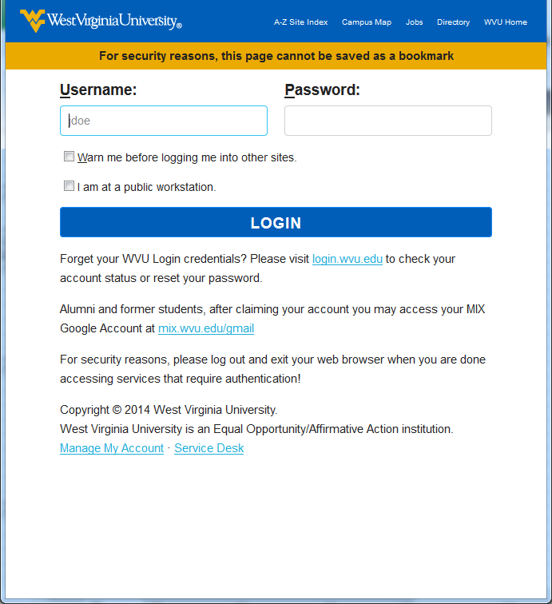
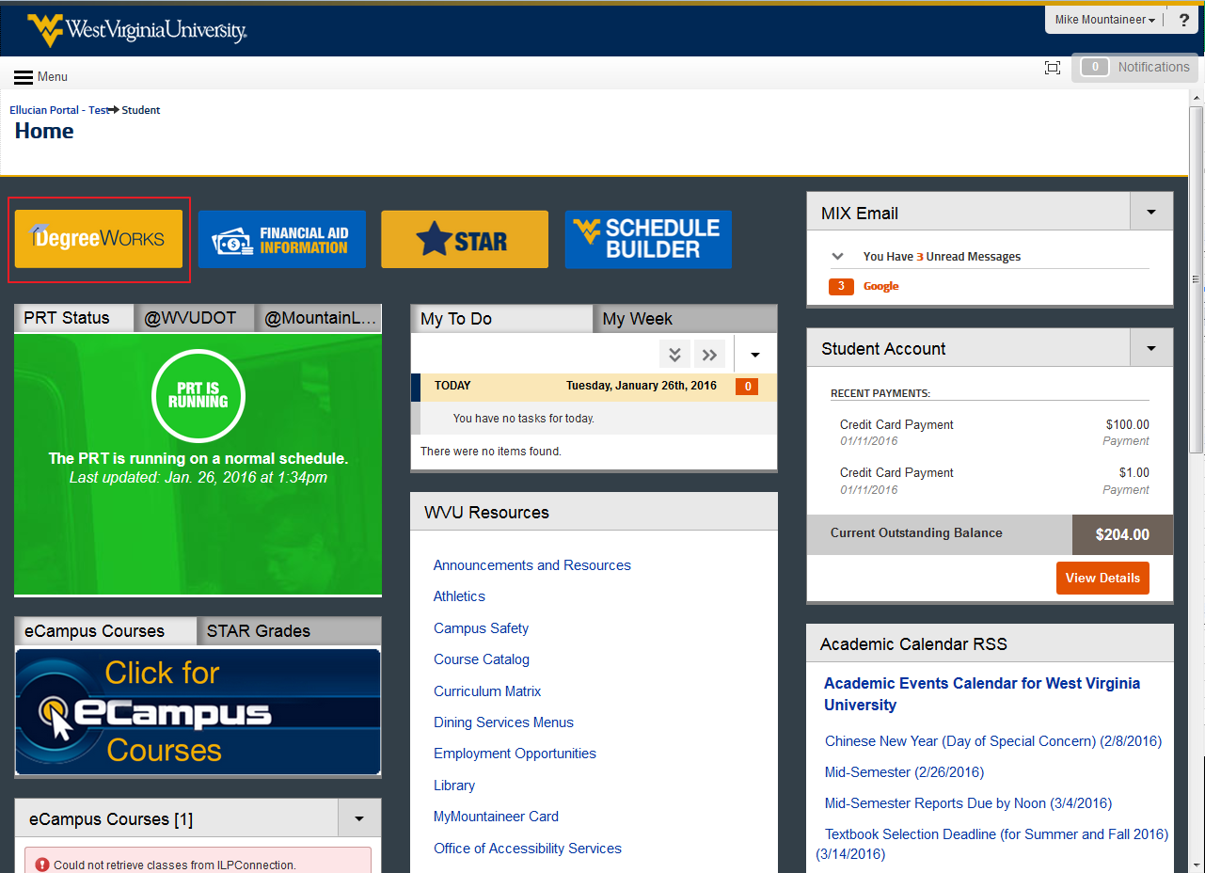
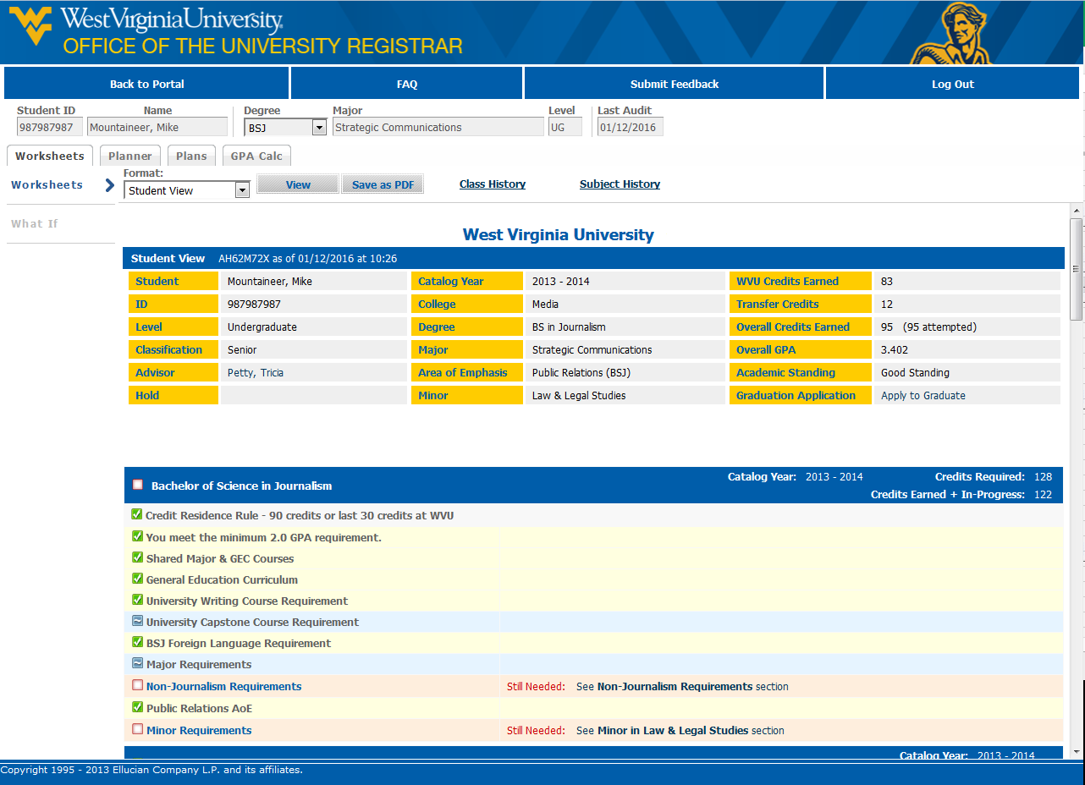
Accessing Degree Works - Students
Log into the WVU Portal with your WVU MYID: https://portal.wvu.edu
Click the Degree Works icon
Degree Works will open in a new window
v6.0 Spring 2016

Slide 8
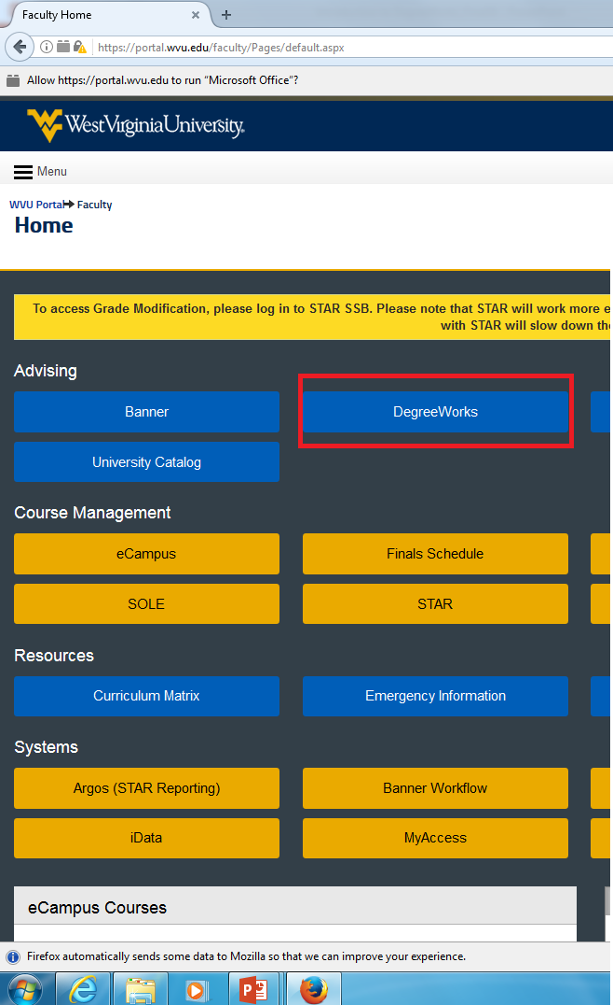
Accessing Degree Works - Advisors
Log into the WVU Portal with your WVU MYID: https://portal.wvu.edu
Click the Degree Works link under “WVU Resources”
Select the current term
Enter a Student’s ID number
v6.0 Spring 2016

Slide 9
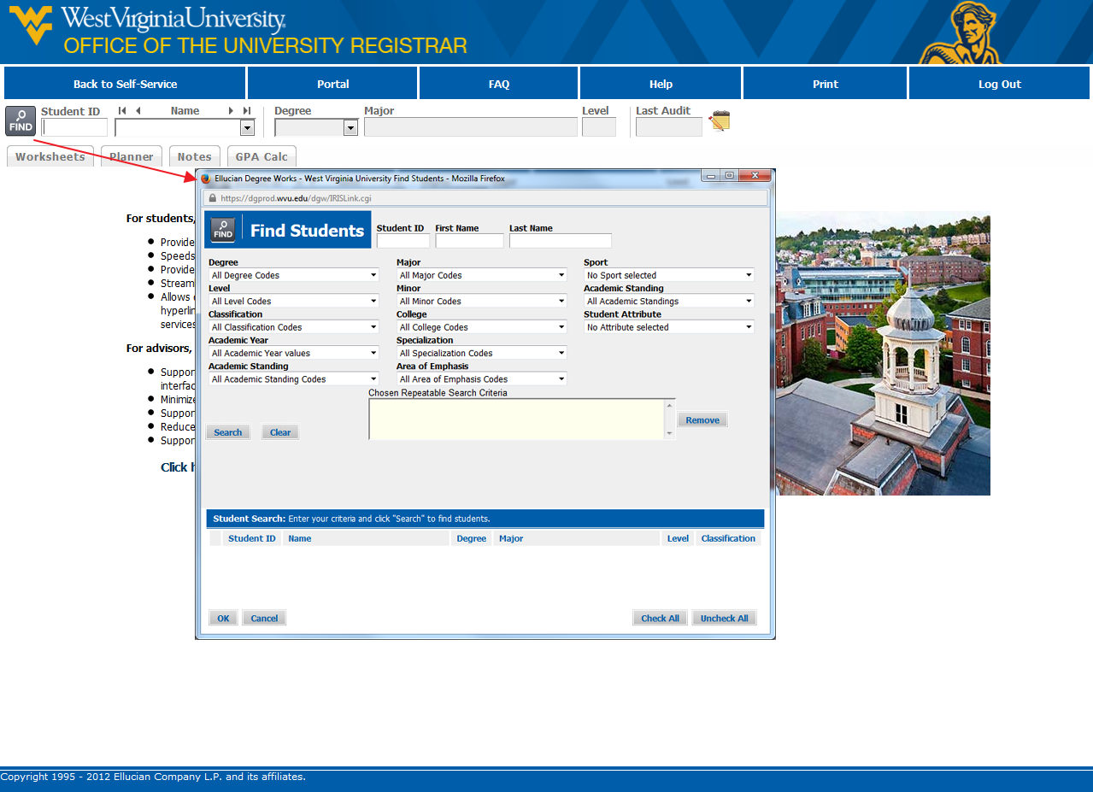
Searching for students
Once you have logged into Degree Works with a Student’s ID number, that student’s audit will display. If you want to view the audit of another student, there are 2 ways to search for students:
Use the Find Button to select criteria to search for Groups of students.
Enter a student’s ID number into the Student ID field and press enter on your keyboard.
v6.0 Spring 2016

Slide 10
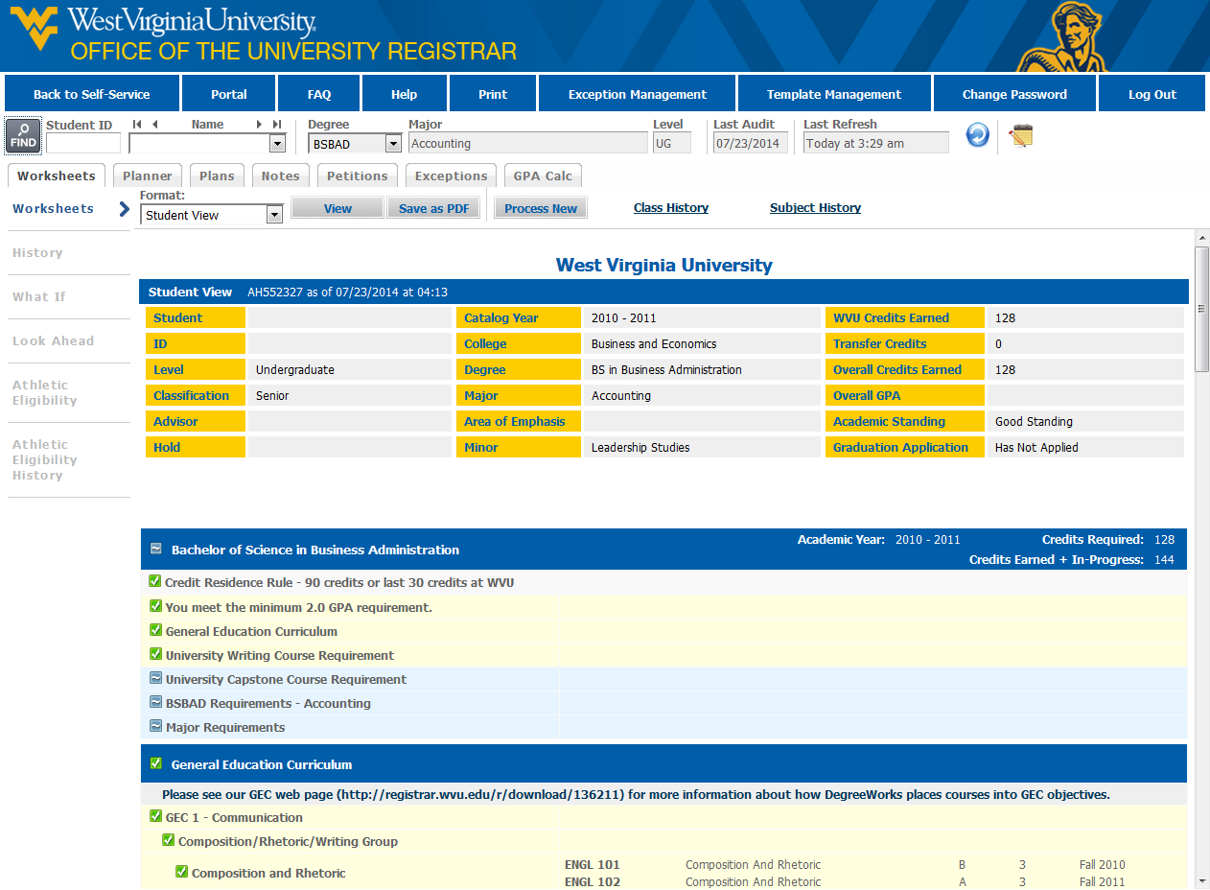
Worksheet overview
The main view after searching for and selecting a student
This view allows for audit analysis and access to additional tools
The worksheet is divided into blocks or sections. Each of these has a bold blue heading.
v6.0 Spring 2016

Slide 11
Student Block
The student block is located at the top of the audit and lists important student information.
Name, ID, Level, Classification, Catalog Year, College, Degree, Major, Minor, AoE, Credit Information, and GPA
v6.0 Spring 2016

Slide 12
Degree Block
The degree block directly below the student block and contains all requirements for that specific degree.
GEC Requirement, Major Requirements, Writing, Capstone, Foreign Language, Minor, AoE
v6.0 Spring 2016

Slide 13
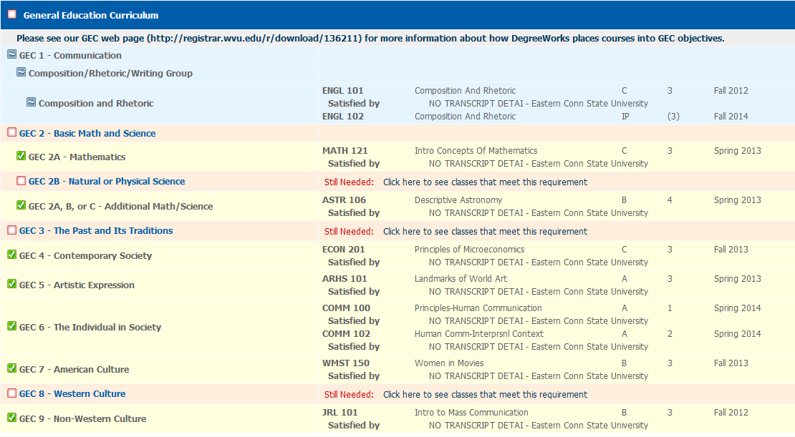
GEF Block
The GEF block lists all GEF Requirements
Transfer credits will display here if they fulfill GEF requirements
Clicking “see classes” links in this section will display the list of GEF courses
v6.0 Spring 2016

Slide 14
Writing & Capstone Blocks
The university writing block and university capstone requirement displays on the audit to indicate if they have been completed.
Clicking on the links in these blocks displays a list of classes that fulfill the requirement
v6.0 Spring 2016

Slide 15
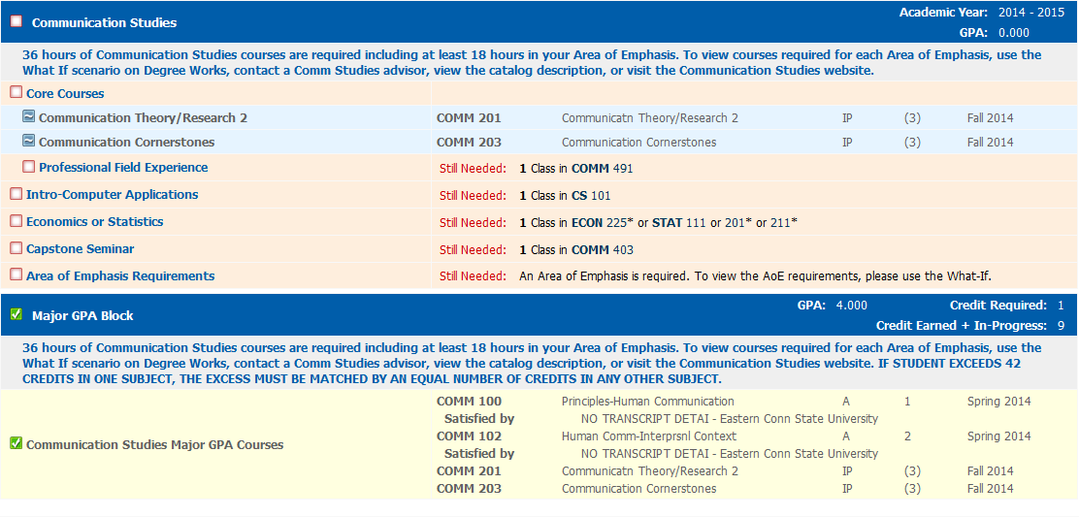
Major block
The major block lists all major coursework requirements as well as GPA requirements and non-course requirements.
v6.0 Spring 2016

Slide 16
In-Progress Block
The in-progress block is located at the bottom of the audit.
It displays courses currently happening and classes registered for in the next term
v6.0 Spring 2016

Slide 17
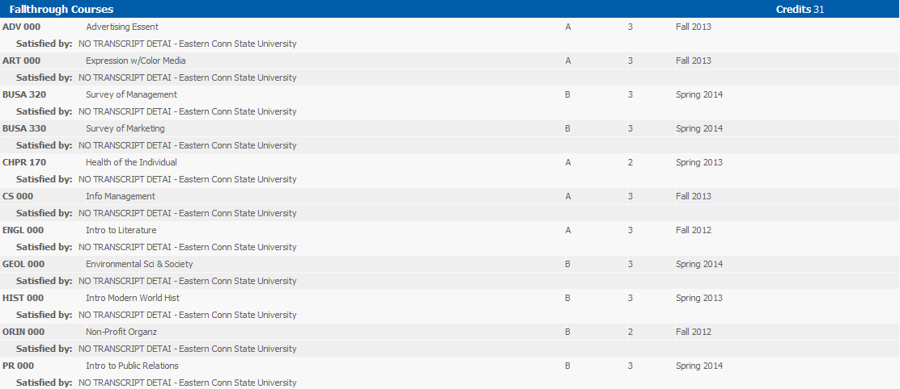
Fallthrough Block
The fallthrough block displays coursework that does not fit into one of the other blocks. Ex. Transfer courses that don’t meet major or GEC requirements, electives, courses taken before a major change.
v6.0 Spring 2016

Slide 18
UNDERSTANDING an audit
Each audit consists of a series of Blocks (identified by the bold, blue heading). These blocks are tailored to meet the specific needs of each college, degree, and major. Check boxes give at-a-glance indication of their status.
The green check mark indicates that the requirement has been satisfied
The blue tilde signifies that the requirement is in-progress
The unmarked red check box indicates that the requirement has not yet been satisfied.
The double tilde signifies a “nearly complete” status (Ex. Course requirements complete, but other requirements are still outstanding)
The @ sign is a wild card. (Ex. JRL 3@ is any 300 level class in Journalism)
Please visit https://registrar.wvu.edu/training-docs for more detailed information about reading an audit.

Slide 19
Additional Functions and Features
PDF – Save an audit as a PDF
Class History – View a semester by semester breakdown of courses
Subject History – View breakdown of classes organized by Subject
Planner – Ensure proper course sequencing by planning a semester by semester schedule
Notes – Keep track of correspondence and important information
GPA Calculator – Help students conceptualize their semester and overall GPA
What If – Create a hypothetical check sheet
v5.0 Fall 2014

Slide 20
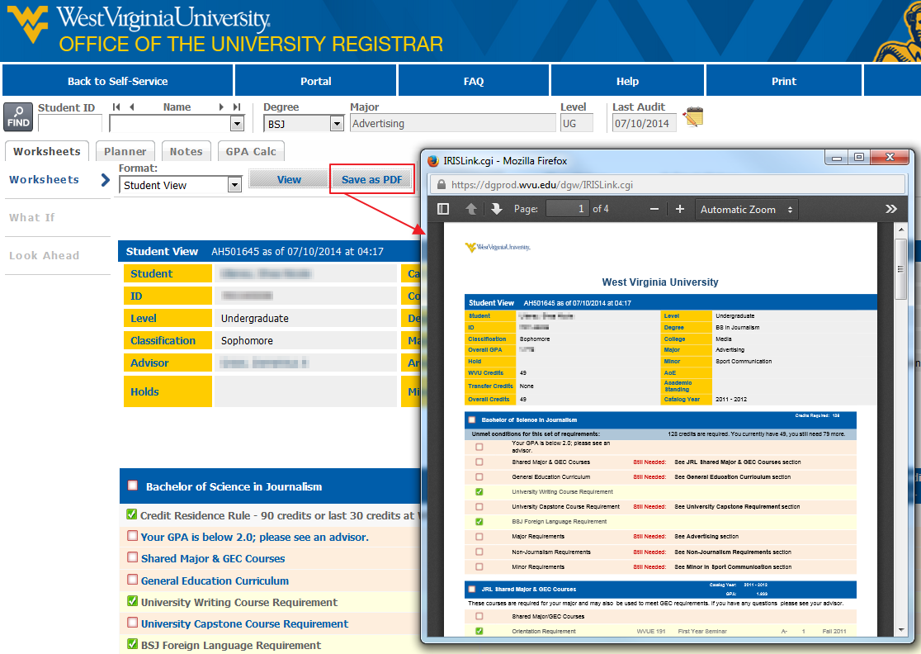
Save as PDF
Use the PDF feature to save or view a PDF copy of the student’s degree audit.
v5.0 Fall 2014

Slide 21
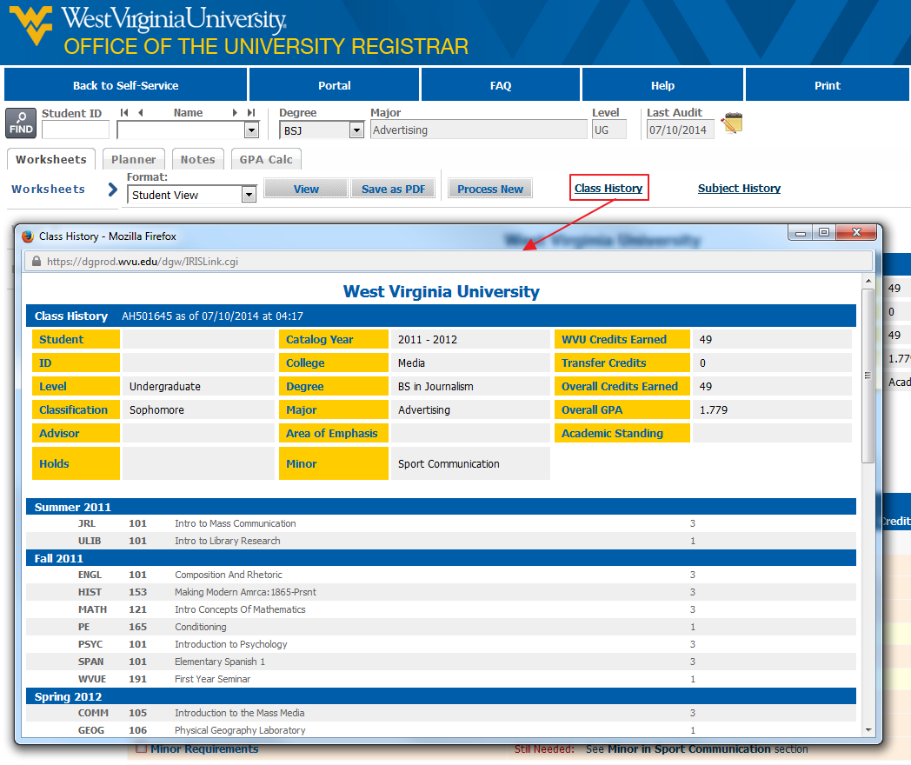
Class History
The Class History tool allows the user to view a list of classes organized by term. This shows previous coursework and classes in progress.
v6.0 Spring 2016

Slide 22
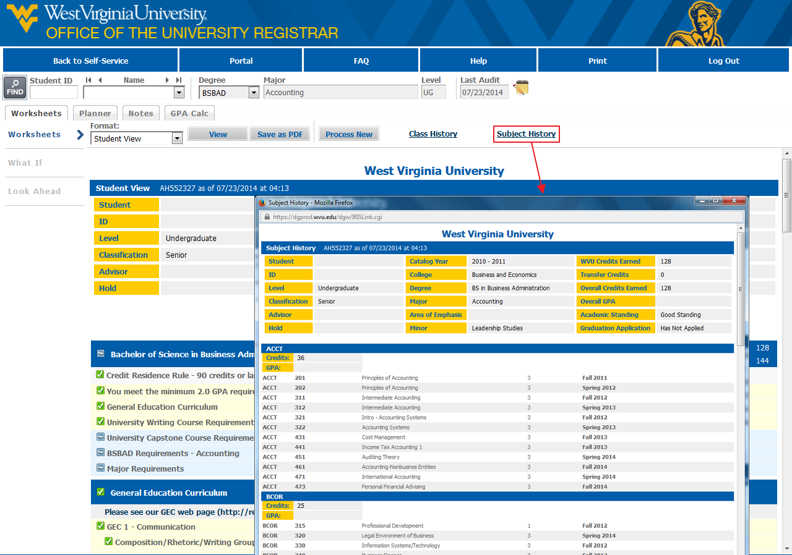
Subject History
The Subject History tool allows the user to view a list of classes organized by Subject. This displays previous coursework and classes in progress.
v6.0 Spring 2016

Slide 23
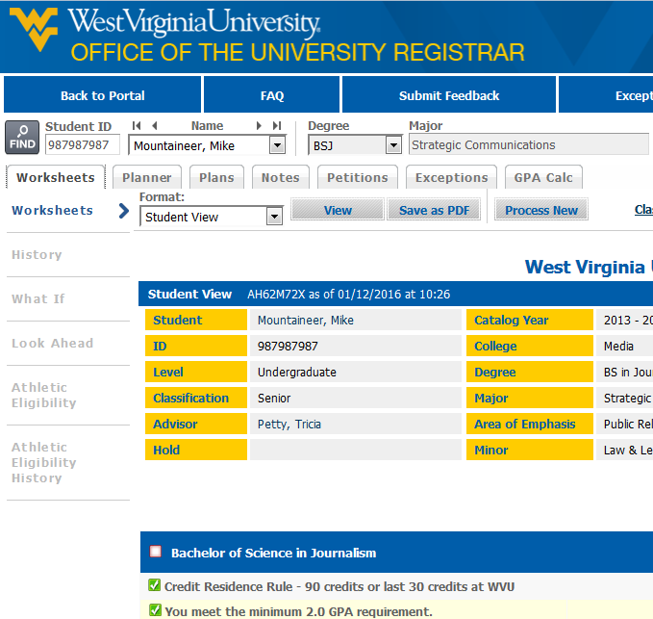
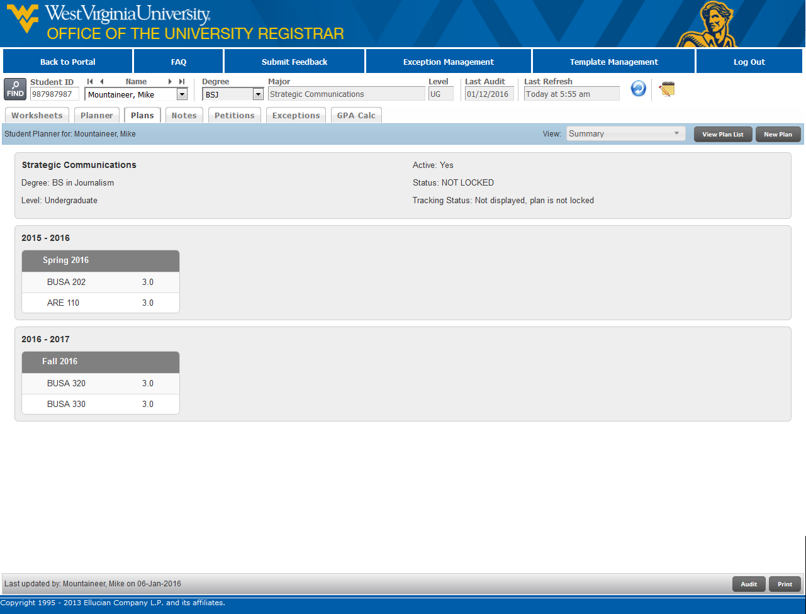
Plans
Plans allows students and advisors to create sequenced plans of study.
A plan is automatically loaded for all new students based on their admitted major.
Once a plan is created, you can modify the courses and requirements. This will allow a customized plan to ensure that the plan will lead successfully to graduation.
For more extensive documentation on the Planner, please visit: http://registrar.wvu.edu/dw
v6.0 Spring 2016

Slide 24
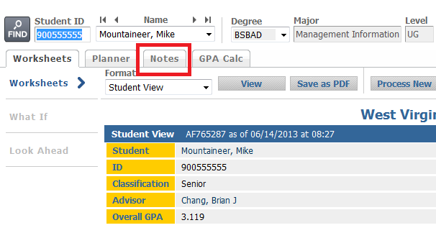
notes
The Notes feature is a great way to keep track of information that pertains to a student’s degree audit or record.
You can use the Notes tab or the Notes Icon to enter notes
Be sure to click Process New after entering a note. This will allow the note to display at the bottom of the student’s audit.
Notes are visible to all Degree Works users including students
v6.0 Spring 2016

Slide 25
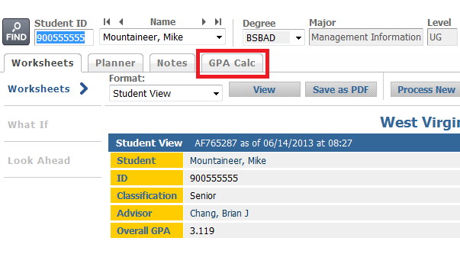
GPA Calculator
Graduation Calculator: Can a student reach his/her desired GPA in the number of credit hours remaining?
Term Calculator: How will grades achieved this term affect a student’s cumulative GPA?
Advice Calculator: How many credit hours with certain grades will achieve a desired GPA?
v6.0 Spring 2016

Slide 26
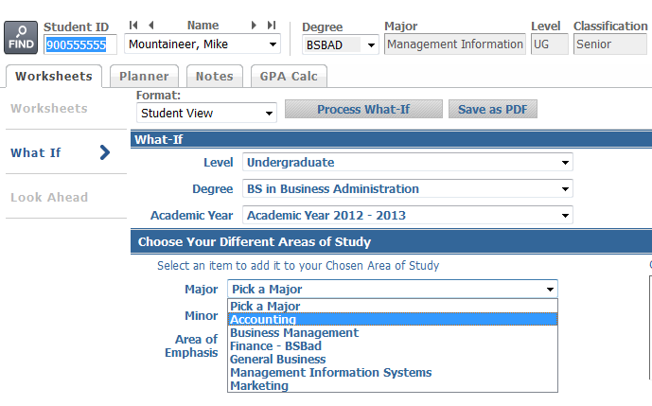
What If
Why do we use the What If feature?
-To hypothesize how a change in academic program (e.g. degree, major, minor) affects previous coursework
NOTE: You must select ALL of the criteria you want to change in the audit (ie: Degree, Academic Year, Major, Minor and AoE)
v6.0 Spring 2016

Slide 27
POSSIBLE IRREGULARITIES
Incorrect curriculum
Academic/Catalog year
Misplaced courses
Pre GEC
Missing attributes
No audit displayed
Pre-2008 students
Students inactive for more than semester
Dual Degree/Double Major
Toggle for second audit
Repeated Coursework
D/F Repeat
Non repeatable
v6.0 Spring 2016

Slide 28
Contact Information:
Office of the University Registrar
304.293.5355
Registrar@mail.wvu.edu
v6.0 Spring 2016

