Slide 1
Introduction to Banner
Welcome to the Introduction to Banner training! We will begin shortly.
West Virginia University
Office of the University Registrar

Slide 2

Training Objectives
Knowledge of WVU’s information security policies as they pertain to Banner
Ability to locate and sign into Banner
Ability to locate and navigate Banner Pages
Ability to find information located in Banner

Slide 3

WVU Data Security
Enterprise Standards for Use of Information Technology
&
Data Security Best Practices

Slide 4
Preparation
WVU collects and maintains personal information from employees and students
  Access and use of this data is governed by federal and state laws, and WVU Policies and Standards
  WVU employees have a shared responsibility to secure this data
  You can be held liable for security breaches due to direct action or inaction

Slide 5
Applicable Laws, Policies, Standards
Federal Law
  Family Educational Rights and Privacy Act (FERPA)
WV State Law
  West Virginia Consumer Credit and
  Protection Act
WVU Board of Governors Policy
  Academics Rule 2.5
WVU ITS Policies and Procedures
  Policy 1.0 Acceptable Use of Data and Technology Resources
Notes:
As stated in the first training objective, we will briefly review WVU’s information security policies as they pertain to Banner. For the sake of time, we’ve listed a more in-depth description on our site for you to review after the training. We wanted to give you a high-level review to start with and you can retrieve the specifics from the documentation.
Some of the key items the document will address include
Enterprise Standards for Use of Information Technology & Data Security Best Practices
The importance of data security
IT Governance and how the WVU Office of Information Technology is empowered to develop standards, guidelines, and procedures for all WVU employees and students.
How to keep your data secure the importance of cybersecurity; don’t share or reuse your password for personal and social medial accounts and being aware of pshing scams
Don’t post WVU information on social media sites

Slide 6

IT Governance
“All ITS Policies, Standards, and Procedures apply to all WVU employees, students, and third parties. These standards define the minimum requirements for each area at WVU. https://it.wvu.edu/policies-and-procedures
Notes:
WVU Office of Information Technology is empowered to develop standards, guidelines, and procedures for all WVU employees and students.

Slide 7
IT Governance
“All ITS Policies, Standards, and Procedures apply to all WVU employees, students, and third parties.”
  Access, Security and Control of Data
    Users are responsible for the protection, privacy, and control of all data, regardless of the data storage medium
      Passwords and user ids may not be shared with anyone under any circumstances
  Individual Accounts
    Users must not give their username(s) and passwords to anyone or permit anyone else to use their Individual Account(s) after personally logging in.
  https://it.wvu.edu/policies-and-procedures/security
Notes:
WVU Office of Information Technology is empowered to develop standards, guidelines, and procedures for all WVU employees and students.

Slide 8

Do NOT reuse your WVU Credentials
Keep your WVU login credentials secure.
  Do not re-use them on private accounts
  The most common security issue reported by WVU users is a simultaneous hack of Facebook and email accounts because the same login credentials were used on both.

Slide 9

Social MEdia
Don’t post WVU business information on your social media accounts
  Data thieves troll these sites to gain information and clues on how to access corporate accounts

Slide 10
Information Security Services
For more information about Enterprise Standards for Use of Information Technology & Data Handling at WVU, and methods to protect your PC and keep your personal identity secure, contact the WVU Information Security Services at:
  defendyourdata@mail.wvu.edu

Slide 11
Directory Information
Directory Information is information contained in a student’s education record that would not generally be considered harmful or an invasion of privacy if disclosed.
Directory Information Includes but is not limited to:
Student’s Name
Address
Telephone Listing
Place of Birth
Major
Limited Use Directory Information
Email Address
Photographs or videos containing student images
Directory Information DOES NOT include:
Date of Birth
Social Security
Student ID Number
Opt Out
Students may refuse to let an institution release directory information.

Slide 12
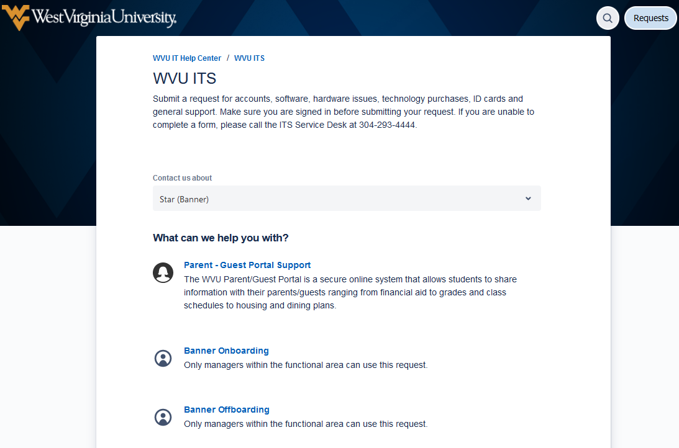

Banner Details
Banner is WVU’s Information System
For Banner access, go to the ITS Help Center for Star (Banner) https://wvu.atlassian.net/servicedesk/customer/portal/5/group/242
  For account creation or adding access, select “Banner Onboarding”
  For account deletion or removing access, select “Banner Offboarding”.
Notes:
Yah, this is new: Must have their supervisor submit this
IT.WVU.EDU>ITS Help Center>WVU ITS>Contact Us About (Scroll Down) “Star (Banner)> Select either Banner Onboarding or Offboarding
How to submit a request
Go to the STAR (Banner) category in the ITS Help Center to submit a ticket for these types of requests:
Banner On Boarding: Request Banner, BDMS, or Workflow access for an employee. This request type is used when a department hires a new employee, or when an employee moves from one internal department to another.
Banner Off Boarding: Remove Banner, BDMS, or Workflow access for an employee.
Edit a Banner Group: Add or remove an existing class to an existing Banner group.
Create a New Banner Group: Request a Banner group and include its associated classes. This request type is used when a department creates a new position that requires the user have Banner access.
Edit a Banner Class: Add or remove objects/forms from an existing Banner class.
Note: Objects owned by other module chairs require approval.
Create a New Banner Class: This request type is used when a department has a new business process that requires access to existing or new forms/objects in Banner and it is essential that these objects/forms be combined into a class together.
Note: Objects owned by other module chairs require approval.
Delete a Banner Group: This request type is used when a department removes a position/role from its organizational chart. If any users are assigned to the group being deleted, the users will be removed before processing the request.
Delete a Banner Class: This request type is fused when a department removes a class. If there are groups assigned to the class being deleted, the class will be removed before processing the request.
Only managers and module leads may submit these requests. Unauthorized requests will be cancelled.

Slide 13
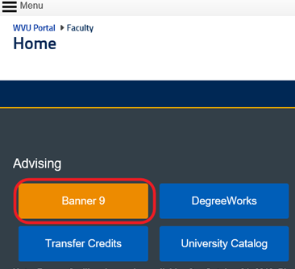
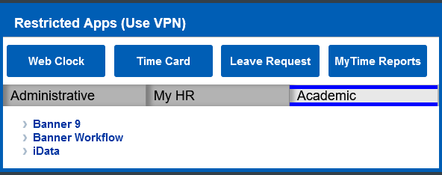
Logging In
Go to https://portal.wvu.edu
Click the Banner 9 Access Button
For password help call ITS at (304) 293-4444

Slide 14
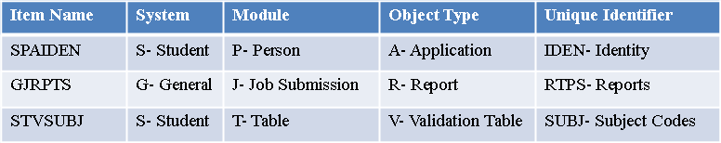
Object Naming Conventions
The unique seven- or eight-character names of Banner objects—forms, reports, jobs, and tables—are assigned according to a set of conventions. Each name is built from the same four components:
System identifier (one or two characters).
Module identifier (one character).
Object type code (one character).
Unique identifier (four characters).

Slide 15
Student System Modules
Form (Object) | Second Letter (Module) | Module | Description
SCADETL | C | Catalog | Course detail at the catalog level
SFAREGQ | F | Registration | Query form for registration
SGASTDN | G | General Student | General student record
SHACRSE | H | Academic History | Graded course information
SIAINST | I | Instructor (Faculty) | Faculty/Advisor status
SRARECR | R | Recruitment | Recruit prospect information
SSADETL | S | Scheduling | Course detail at the section level
The second letter of the Form name is the Module indicator. The module gives us a clue as to what type of information the form contains.

Slide 16
navigation
The Welcome Screen
1. Pop-out menu.
2. Search that stays on the top of the screen.
3. Folder to access recently used pages.
4. Search bar in the middle of the screen.
5. User’s name at the top right.
6. Sign Out - Don’t use! Just close your browser to exit.
7. Help is activated when a page is displayed.
8. Shortcut Keys menu.

Slide 17
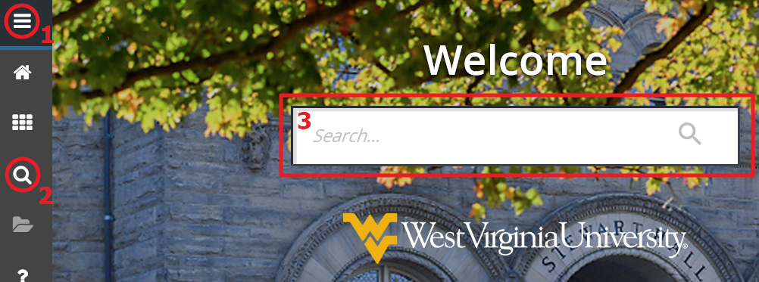
Searching – Three Methods
1. Search Method One: Pop-Out Menu. The menu icon is located in the upper left corner of the application. Click this icon to open the Banner Menu. Click the cascading choices until you reach the page you need.
2. Search Method Two: Magnifying Glass Search Icon. Click this icon to open the Search window. You can either enter a descriptive name of the page or the Banner acronym for the page. As you type, possible matches are displayed. Click the correct entry.
3. Search Method Three: Search Bar. Enter the descriptive name of the page or Banner acronym for the page. As you type, possible matches are displayed. Click the correct entry.

Slide 18
Page Navigation
Page Header
1. Page Close Icon.
2. Page Title.
3. Add icon – used with Banner Document Management.
4. Retrieve icon - used with Banner Document Management.
5. Related – Displays a list of pages that can be accessed from this page. These are defined
on the Options Maintenance Menu (GUAOPTM) page.
6. Tools Menu: includes refresh, export, print, clear record, clear data, item properties, display
ID image, and other options controlled by the page..
7. Go (Keyboard shortcut Alt+Page Down) (Next Block in Banner 8)
(Release and Submit buttons which are used only with a workflow.)

Slide 19
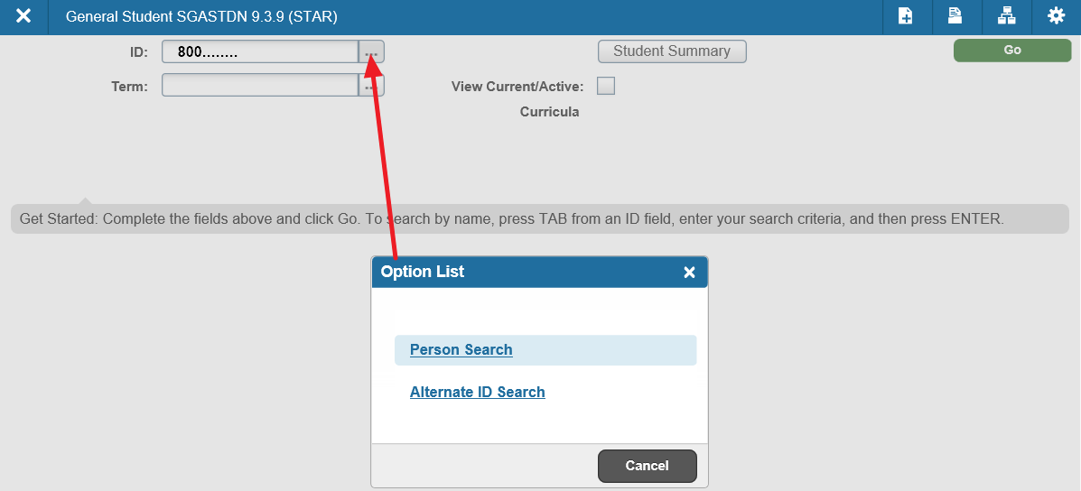
Student search
Type in student’s 800 id number or select by name from ‘Option List’

Slide 20
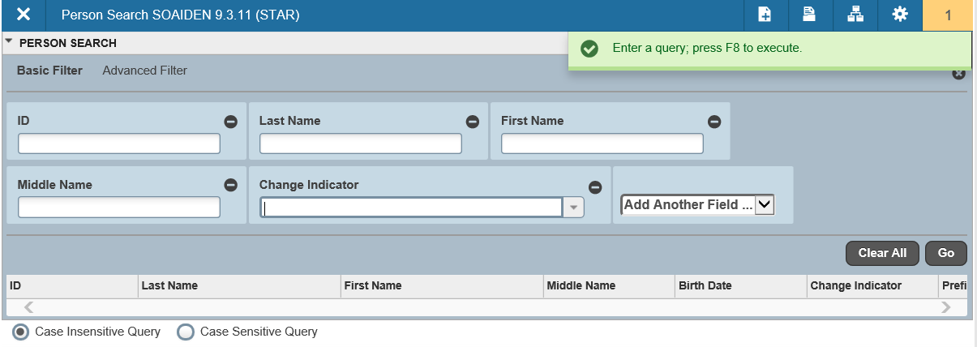
Person search Query
If you are unsure of a student’s ID number you can use Person Search to look them up.
A percent sign (%) can be used as a wildcard.

Slide 21
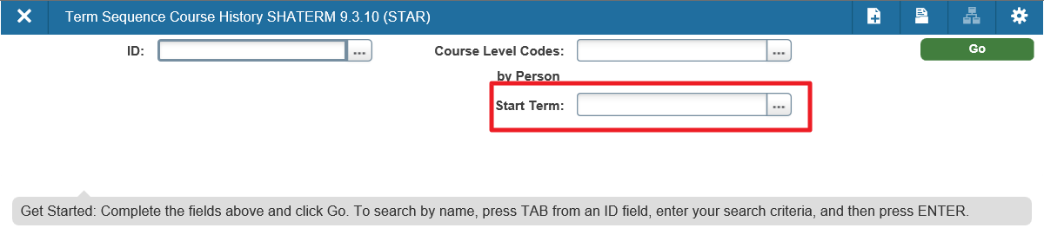

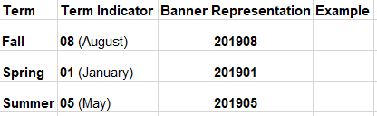
Banner and Term

Slide 22
Quick Recap
Pages are the Objects that we use most in Banner
There are three ways to access Pages
We use Person Search to find people in Banner
Some pages require a term in the Key Block

Slide 23
For more information Please Contact:
Office of the University Registrar
Degree Works Team
304.293.5355
degreeworks@mail.wvu.edu

