Slide 1
Processing Exceptions
Welcome to the Introduction to Banner training! We will begin shortly.
West Virginia University
Office of the University Registrar
Notes:
Take note of attendance for granting access
Introductions & Expectations
Exceptions Training
If you haven't yet, in order to complete your exceptions access request, you will need to fill out and submit the form here -
https://registrar.wvu.edu/files/d/6f00a185-5d4e-4c58-8528-bff2c95a0f28/degreeworks-exceptions.pdf
Send completed form to Degreeworks@mail.wvu.edu
Access granted in 1-2 days after this training along with completed form

Slide 2
Contents
Banner and DegreeWorks
Exception Types and Uses
Force Complete
Substitute
Also Allow
Apply Here
Remove Course and/or Change the Limit
Incorrect Exceptions
Possible Errors

Slide 3
About Exceptions
What do exceptions do?
Exceptions modify requirements to make overrides or substitutions
Exceptions can “check” off particular requirements
Why are they needed?
If a course is cancelled
If a course doesn’t possess a particular course attribute
If a student changes majors or catalog years and overrides are necessary
If resorting manually would better serve the student than the “Best-Fit” Algorithm Degree Works uses

Slide 4
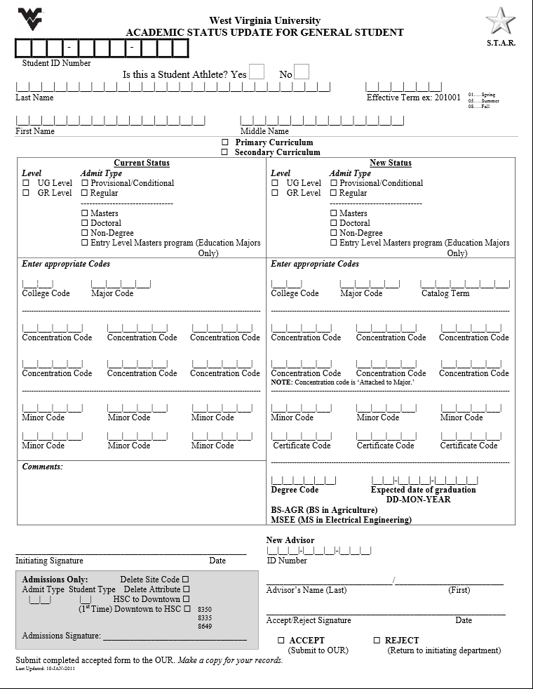
Banner and Degree Works
Before processing exceptions and planning courses, ask:
Does Degree Works show Everything that the student should have listed in Banner?
- Is the Catalog Year correct? - Is the Degree correct? - Is the Major accurate? - Are all of the Minors and AoEs listed?
If the answer to ANY of these is no, go to https://registrar.wvu.edu/forms and complete an Academic Status Update form.
This will update their record in Banner, which will then update Degree Works.
DO NOT DO EXCEPTIONS UNTIL THE BANNER INFORMATION IS ACCURATE.

Slide 5
Exceptions processing
Degree Works allows advisors to make edits to the audit on a case by case basis.
The exception tools are accessed by clicking the exceptions tab at the top of the student’s audit.
Exception Types Include: - Force Complete - Substitute - Also Allow - Apply Here - Remove Course/
Change the Limit

Slide 6
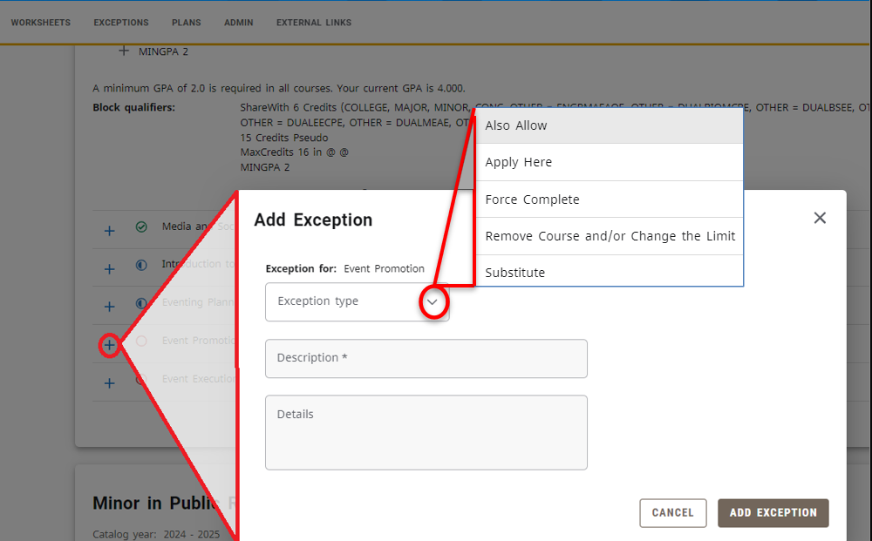
Adding Exceptions
Select the “Exceptions” tab at the top to enter Exception Mode
Locate the requirement for which you wish to apply an exception
Select the “Add Exception” Icon (+)
Select “Exception Type” and Enter Required information
Click “Add Exception”

Slide 7
Remove Exceptions
1) Select the “Exceptions” tab at the top to enter Exception Mode
2) Select the Exception you wish to remove
3) Click ‘Remove Exception’ Icon

Slide 8
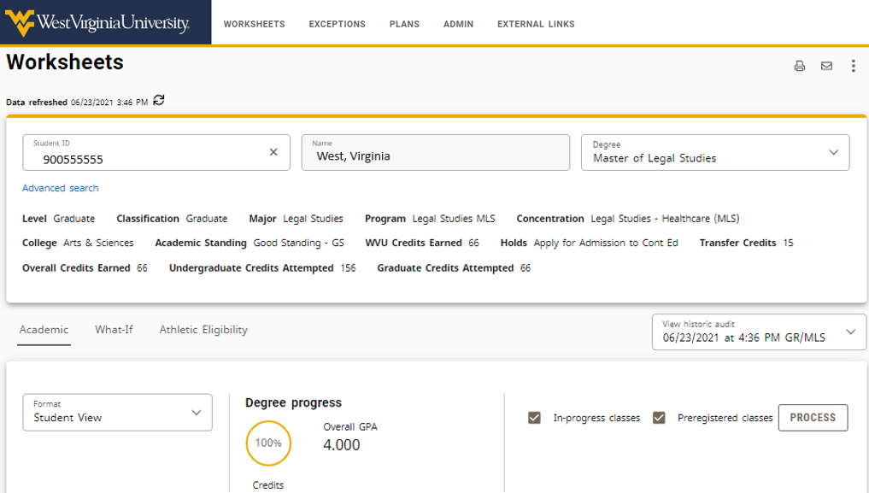
Refresh the Audit
To view the added or removed exception
Wait for the overnight refresh or
Navigate to the WORKSHEETS tab and select PROCESS

Slide 9
Force Complete
This exception is the most powerful and should be used with the most care. It completes a course rule, subset rule, block qualifier or rule qualifier without applying additional classes.
Using a Force Complete can mean that the student is not required to complete a specific requirement.
Most common Force Complete: Non Course Requirements such as “Thesis” or “Dissertation”

Slide 10
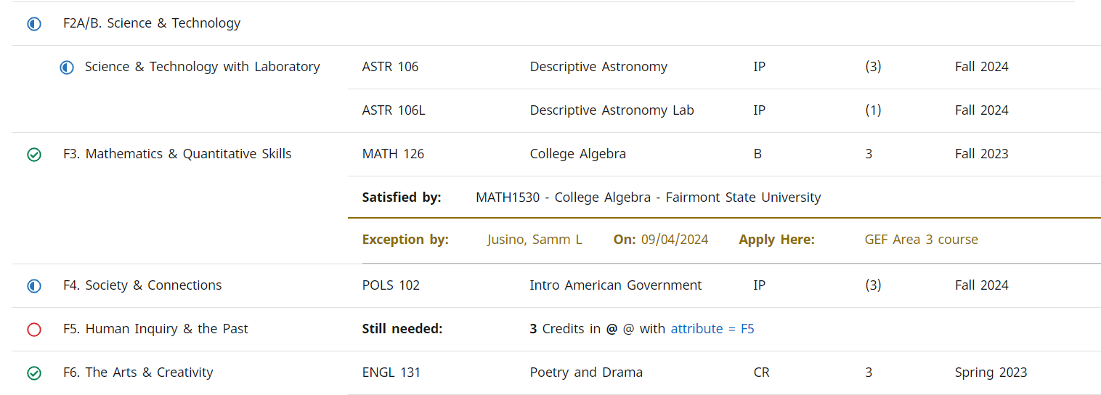
Apply Here
We use Apply Here to move courses around on the degree audit. It allows a course to apply for a rule when not provided as an option.
Reasons we need to move courses around: - Missing Attributes - Genuine Exceptions - Transfer Courses - Sorting Error
Overrides scribing, rule, and block qualifiers
Apply Here should not be used for In-Progress courses.

Slide 11
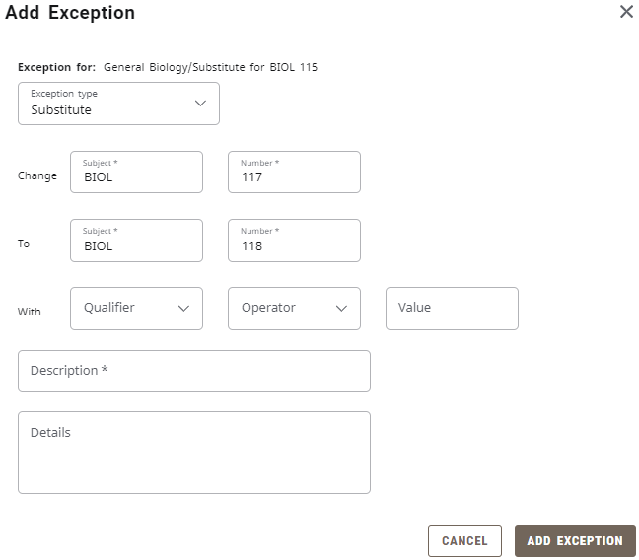
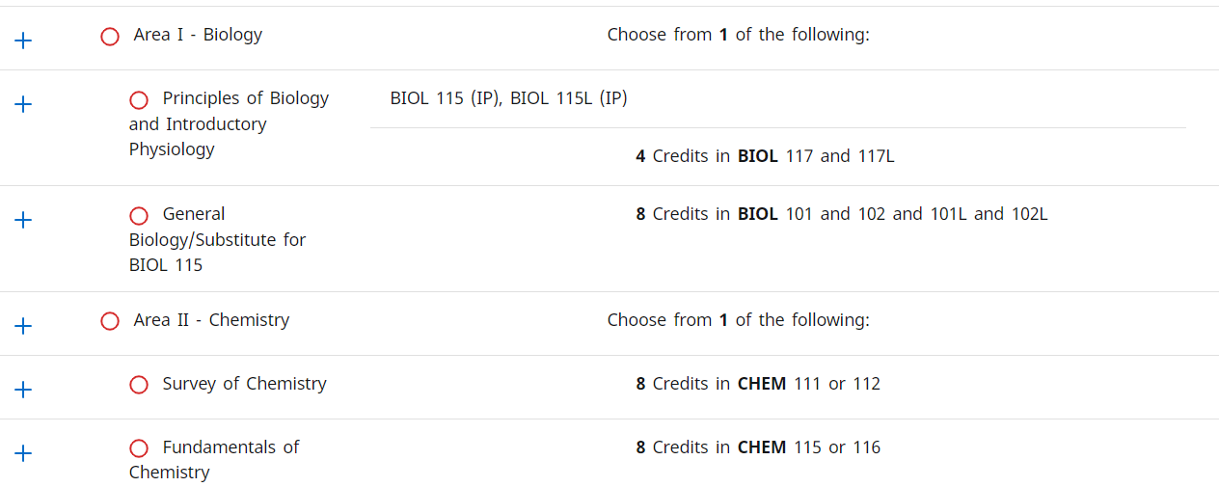
Substitute
Used to substitute one course for another.
If multiple classes are required then the substituted course is exchanged for the other courses.
Substitution can be applied before or after the alternate course is taken; it is safe to use on In Progress courses.

Slide 12
Also Allow
This exception appends a course to a course list on a rule.
Use when you wish to expand the course options available for a specific requirement. In many instances this is a better option that using the Substitute exception.
Also Allow can be applied before or after the alternate course is taken; it is safe to use on In Progress courses.

Slide 13
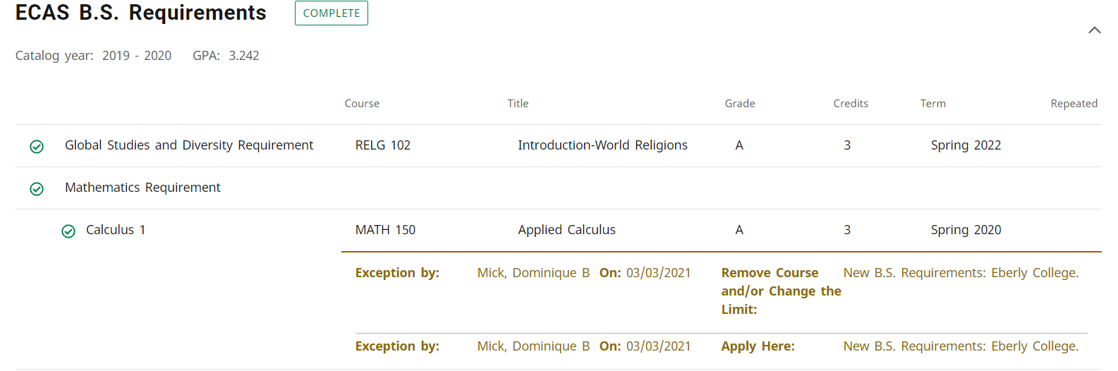
Remove Course and/or Change the limit
This exception allows you to remove a class from a course rule or qualifier or to change the number of classes or credits required on a rule or qualifier.
Most common Change the Limits:
Partially satisfied elective requirements
Accepting a course that has less credit hours to fulfill a requirement

Slide 14
Incorrect Exceptions
Exceptions without description indicating why the exception has been made are considered incorrect.
We do not monitor or police which courses can be substituted or which requirements Departments choose to waive but our Graduation team does look at every audit to ensure that Exceptions are being used properly.

Slide 15
Exceptions Errors
These types of exceptions will be removed by the Office of the University Registrar and could lead to the revocation of exceptions access:
Exceptions placed on the Degree block
Force Completes that should be Apply Here
Force completed university requirements
Force completes that should be Change the Limits
In progress courses moved by Apply Here

Slide 16
Contact Information:
Office of the University Registrar
Degree Works Team
304.293.5355
degreeworks@mail.wvu.edu
v5.0 Fall 2014

