Slide 1
Introduction to Degree works
West Virginia University
Office of the University Registrar
Version Fall 2024

Slide 2
Training Contents
Objectives
Background information on Degree Works
Degree Works and Banner
Accessing Degree Works
Searching for students
Block Explanations
Reading an audit
Additional Features
Class History
Subject History
Plans
Notes
GPA Calculator
What If
Possible Irregularities
Version Fall 2024
Notes:
1st half of presentation - PPT screenshots
2nd half of presentation – Demo of Degree Works

Slide 3
Training Objectives
How to use criteria for identifying populations
Understand and interpret an audit
Understand how the University Catalogs and Degree Works are tied together
Utilize additional audit and student analytic tools
Version Fall 2024

Slide 4
What is Degree Works?
A web based tool that provides a clear and convenient method for students and advisors to track degree progress, prepare for registration, and plan for graduation
Degree Works is designed to aid and facilitate academic advising and degree completion
Degree Works is used by undergraduate, graduate, and professional students for graduation certification. All undergraduates must have a complete degree works audit in order to graduate.
Degree Works is catalog driven and coded based on the requirements of a given catalog year
Version Fall 2024

Slide 5
Who Can use degree works?
All currently enrolled students can access Degree Works through MIX
All WVU personnel who are listed as Advisor in Banner have access to Degree Works.
Please visit http://registrar.wvu.edu/forms to access the Advisor Information form if you need access to Degree Works and currently do not
Version Fall 2024
Notes:
If a given student is inactive, or a new student hasn’t registered, they may not have a Degree Works audit.

Slide 6
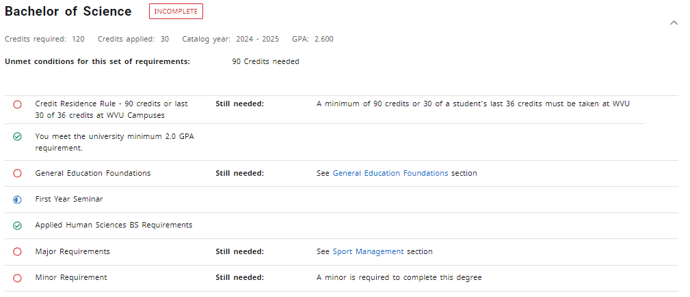
Degree Works and BAnner
Degree Works gets all its student information directly from Banner.
Catalog/ Academic Year
Academic Program
GPA
Classification
WVU/Transfer coursework
Advisor
Holds
Version Fall 2024
Notes:
Does Degree Works show Everything that the student should have listed in Banner?
- Is the Catalog Year correct? - Is the Degree correct? - Is the Major accurate? - Are all of the Minors and AoEs listed?

Slide 7
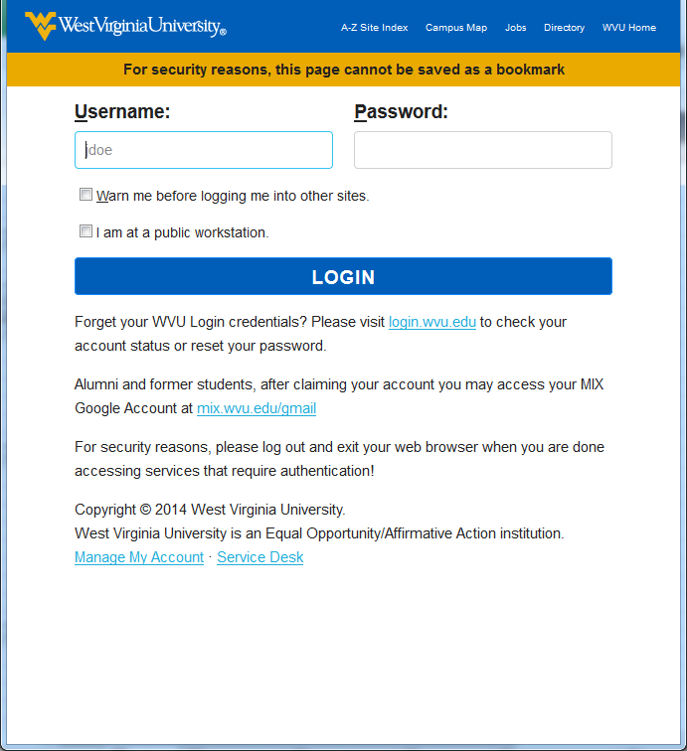
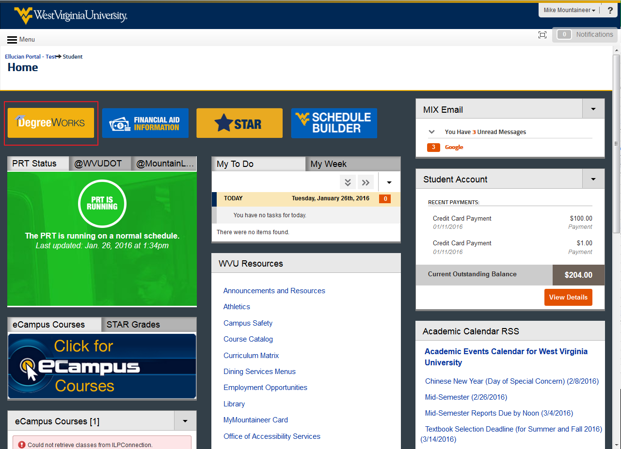
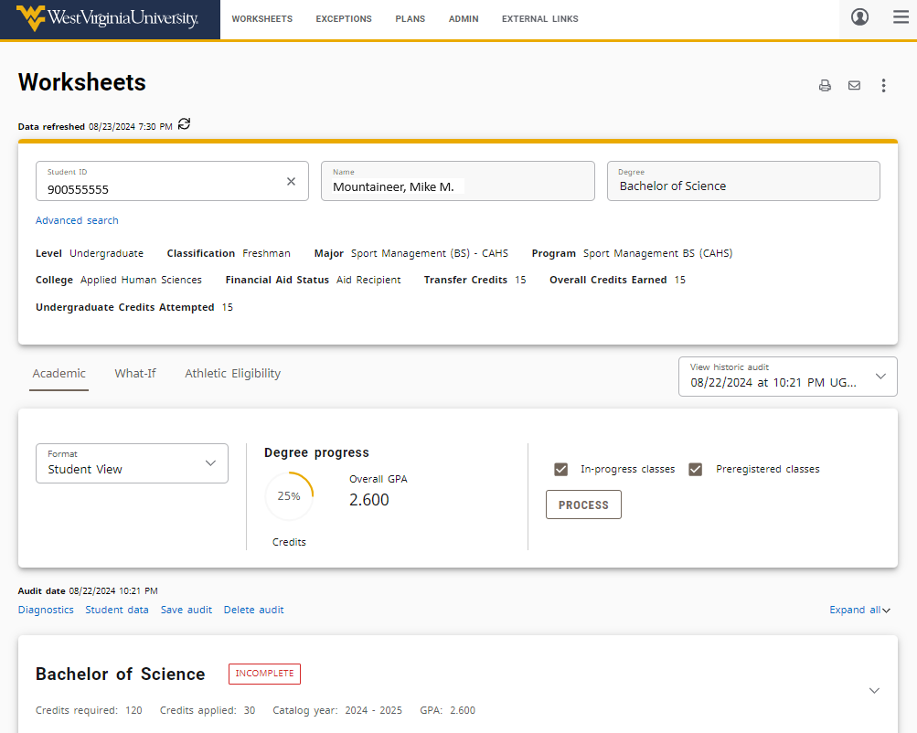
Accessing Degree Works - Students
Log into the WVU Portal with your WVU MYID: https://portal.wvu.edu
Click the Degree Works icon
Degree Works will open in a new window
v6.0 Spring 2016

Slide 8
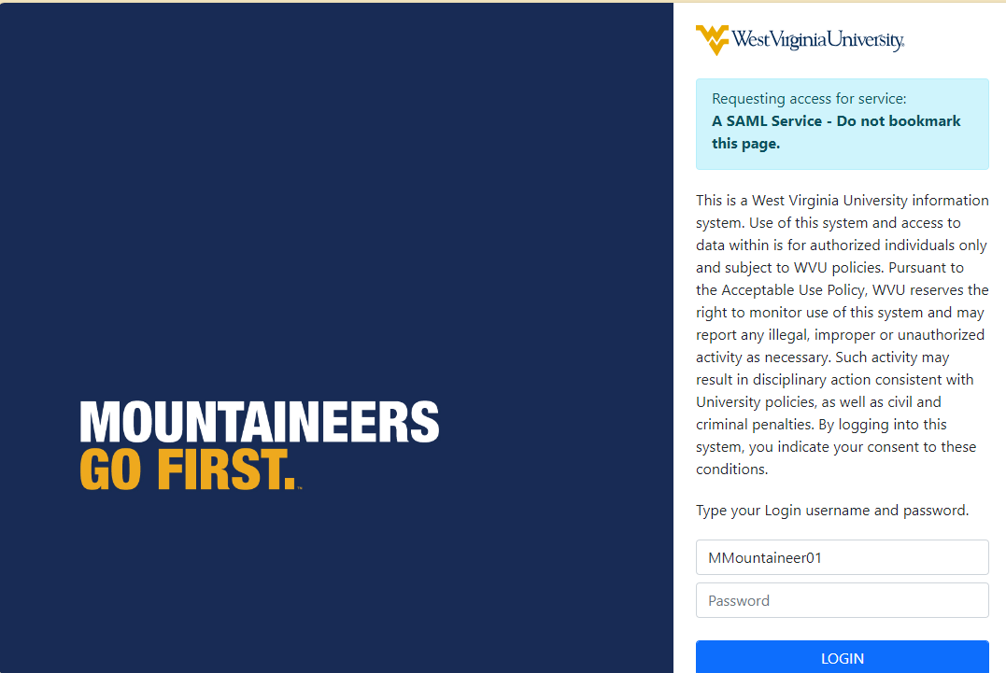
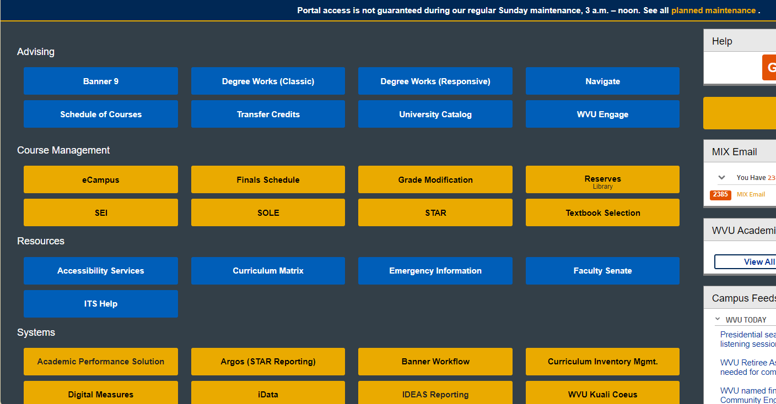
Accessing Degree Works - Advisors
Log into the WVU Portal with your WVU MYID: https://portal.wvu.edu
Click the Degree Works icon
Degree Works will open in a new window
Enter a student’s ID number
Version Fall 2024

Slide 9
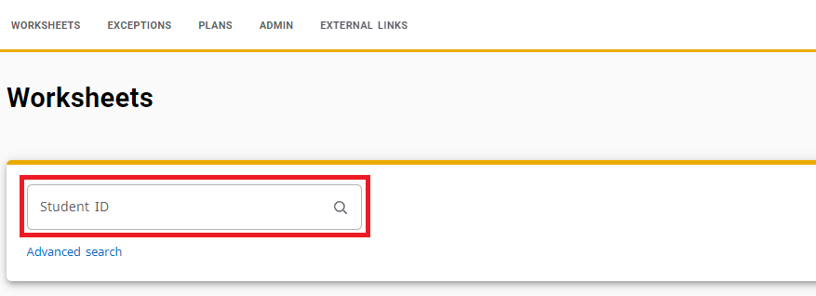
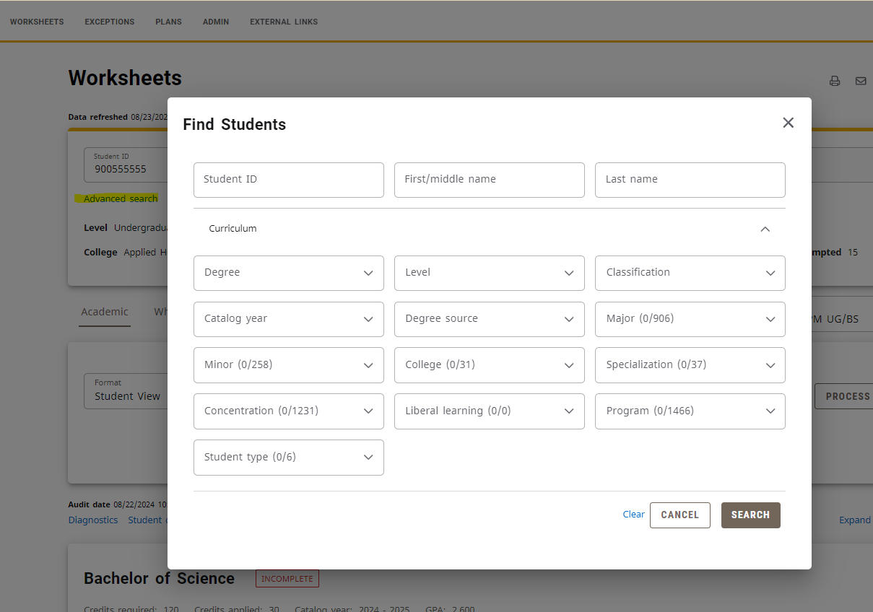
Searching for students
Once you have logged into Degree Works with a Student’s ID number, that student’s audit will display. If you want to view the audit of another student, there are 2 ways to search for students:
Enter a student’s ID number into the Student ID field and press enter on your keyboard.
Use the Advanced Search link to select criteria to search for Groups of students.
Version Fall 2024

Slide 10
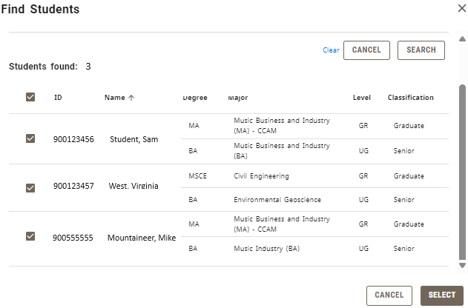
Selecting Multiple students
Multiple results may return after using advanced search.
Use the checkboxes to toggle selection. To select or deselect the entire column, select the checkbox in the top row.
Scroll down to the bottom of the results and push the “Select button” for results.
On the Worksheets screen, use the “Select Student” drop down to generate one of your chosen student’s audits.
Version Fall 2024

Slide 11
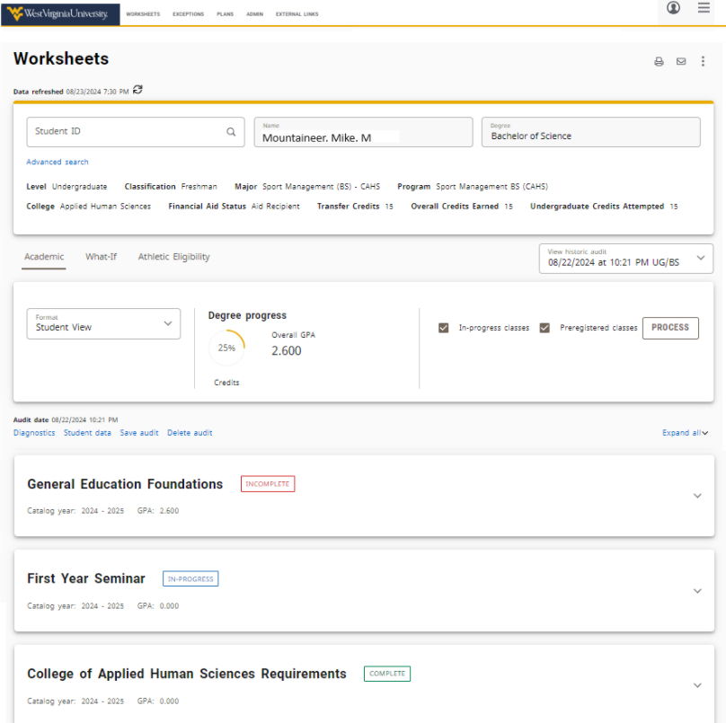
Worksheet overview
The main view after searching for and selecting a student
This view allows for audit analysis and access to additional tools
The worksheet is divided into blocks or sections. Each of these sections may be expanded or collapsed.
Version Fall 2024

Slide 12
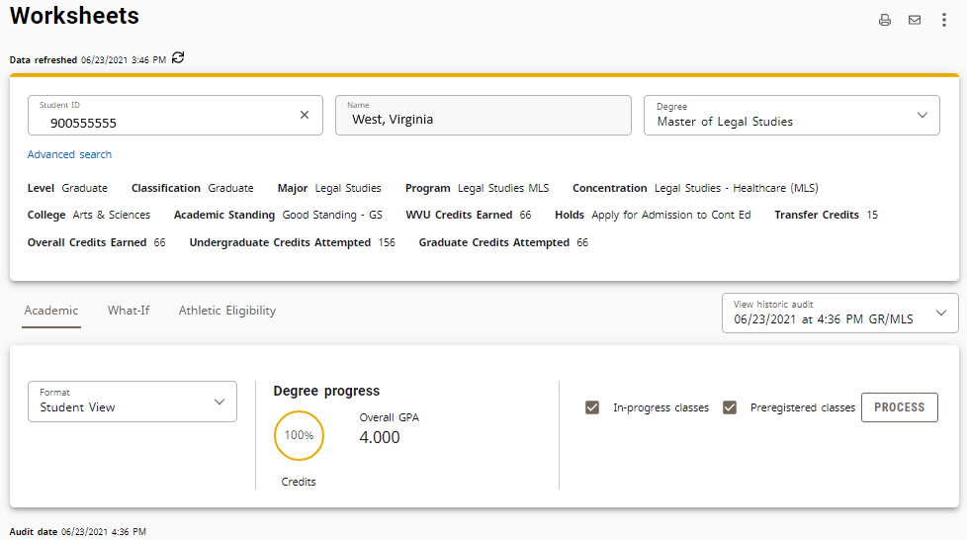
Student Block
The student block is located at the top of the audit and lists important student information.
Name, ID, Level, Classification, Catalog Year, College, Degree, Major, Minor, AoE, Credit Information, and GPA
The information here is dynamic; if the data doesn’t exist, it will not appear
Version Fall 2024
Notes:
Dynamic Data Example: Transfer Credit

Slide 13
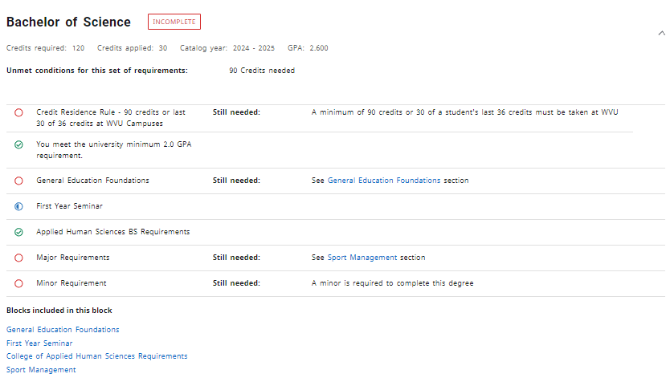
Degree Block
The degree block appears before all other curricula blocks and contains all requirements for that specific degree.
GEF Requirements, Major Requirements, College/Program Requirements, Minor, AoE, ect.
Version Fall 2024

Slide 14
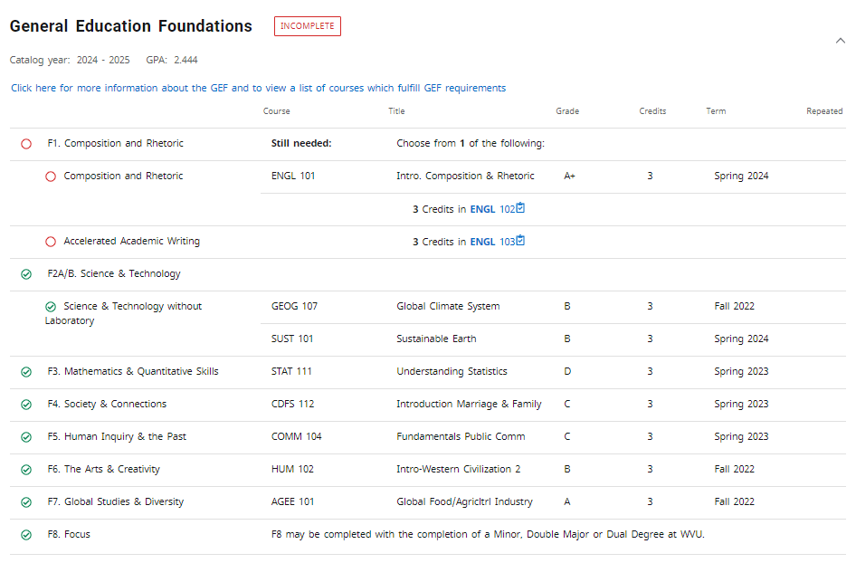
GEF Block
The GEF block lists all GEF Requirements
Transfer credits will display here if they fulfill GEF requirements
Clicking “see classes” links in this section will display the list of GEF courses
Version Fall 2024

Slide 15
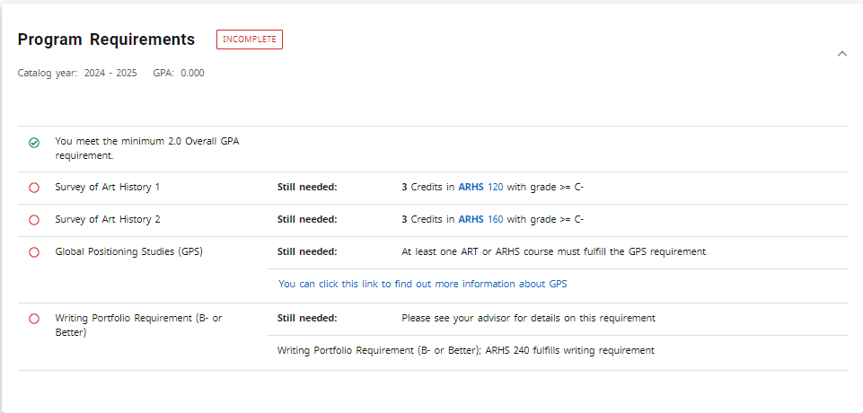
College Block
The block is typically listed before the major and displays college level requirements. The coursework here varies between colleges and may display requirements common across the college for all majors or may display fundamental requirements particular to a given major or department.
Version Fall 2024
Notes:
Capstone blk ended 2020-2021 (last used 1920)
Writing ended 2016-2017 (last used 1516)
GEF 2016-17 (GEC 1516)
College Block 20-21+

Slide 16
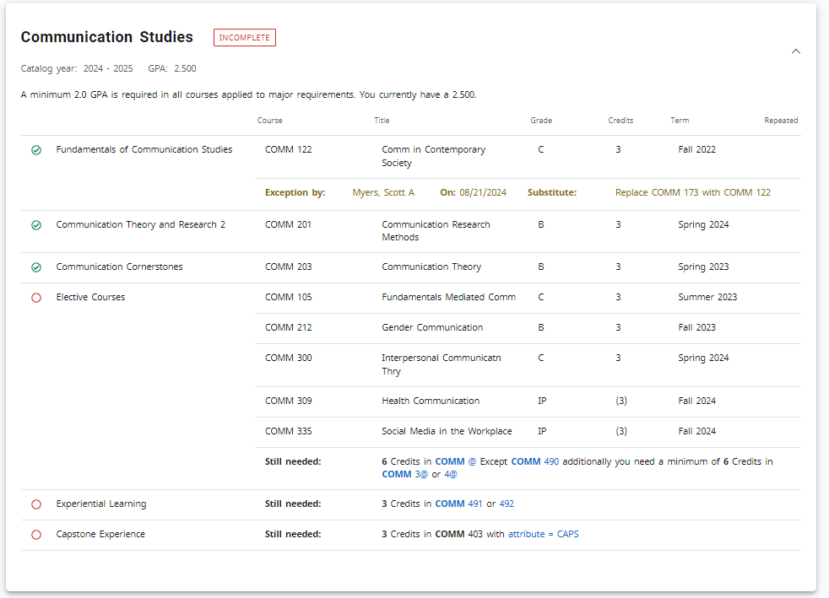
Major block
The major block lists all major coursework requirements as well as GPA requirements and any non-course requirements.
Version Fall 2024

Slide 17
In-Progress Block
The in-progress block is located at the bottom of the audit.
It displays courses currently happening and classes registered for in the next term
Version Fall 2024

Slide 18
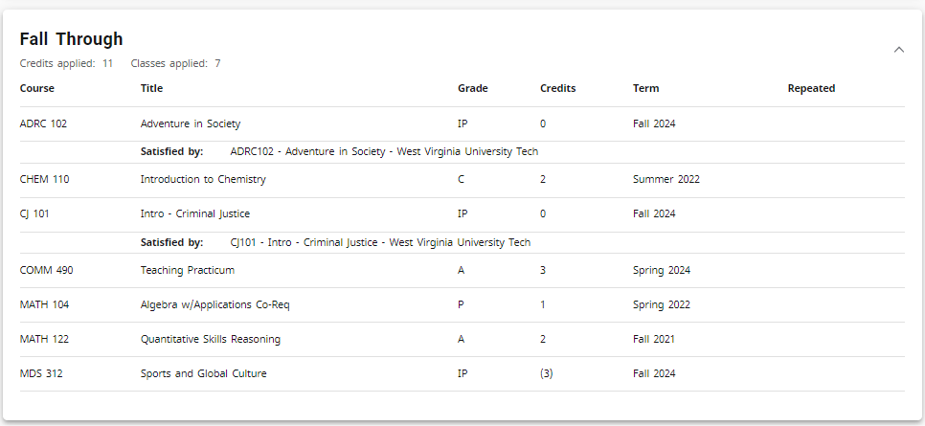
Fallthrough Block
The fallthrough block displays coursework that does not fit into one of the other blocks. Ex. Transfer courses that don’t meet major or GEF requirements, electives, courses taken before a major change.
Version Fall 2024

Slide 19
UNDERSTANDING an audit
Each audit consists of a series of Blocks (identified by the bold, blue heading). These blocks are tailored to meet the specific needs of each college, degree, and major. Check boxes give at-a-glance indication of their status.
The green check mark indicates that the requirement has been satisfied
The blue tilde signifies that the requirement is in-progress
The unmarked red circle indicates that the requirement has not yet been satisfied.
The double tilde signifies a “nearly complete” status (Ex. Course requirements complete, but other requirements are still outstanding)
The @ sign is a wild card.
Courses with repeat indicators in Banner

Slide 20
Additional Functions and Features
PDF – Save an audit as a PDF
GPA Calculator – Help students conceptualize their semester and overall GPA
Class History – View a breakdown of course details by
Notes – Keep track of correspondence and important information
Student Data– View a breakdown of curricula information course details and attributes
Plans – Ensure proper course sequencing by planning a semester by semester schedule
What If – Create a hypothetical check sheet
Version Fall 2024
Notes:
Student data replaces subject history for advisors. They should have this view now.

Slide 21
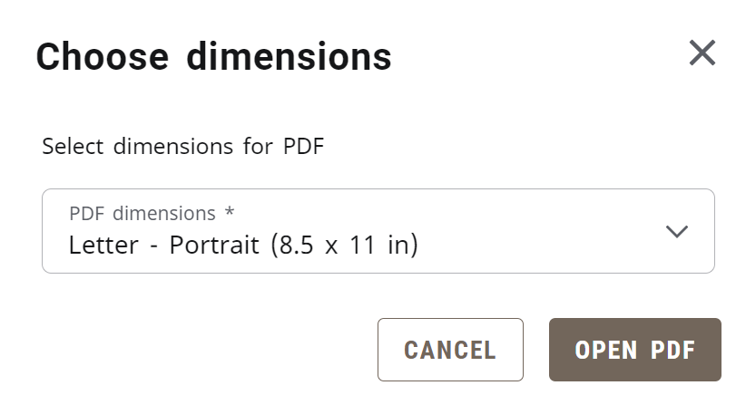
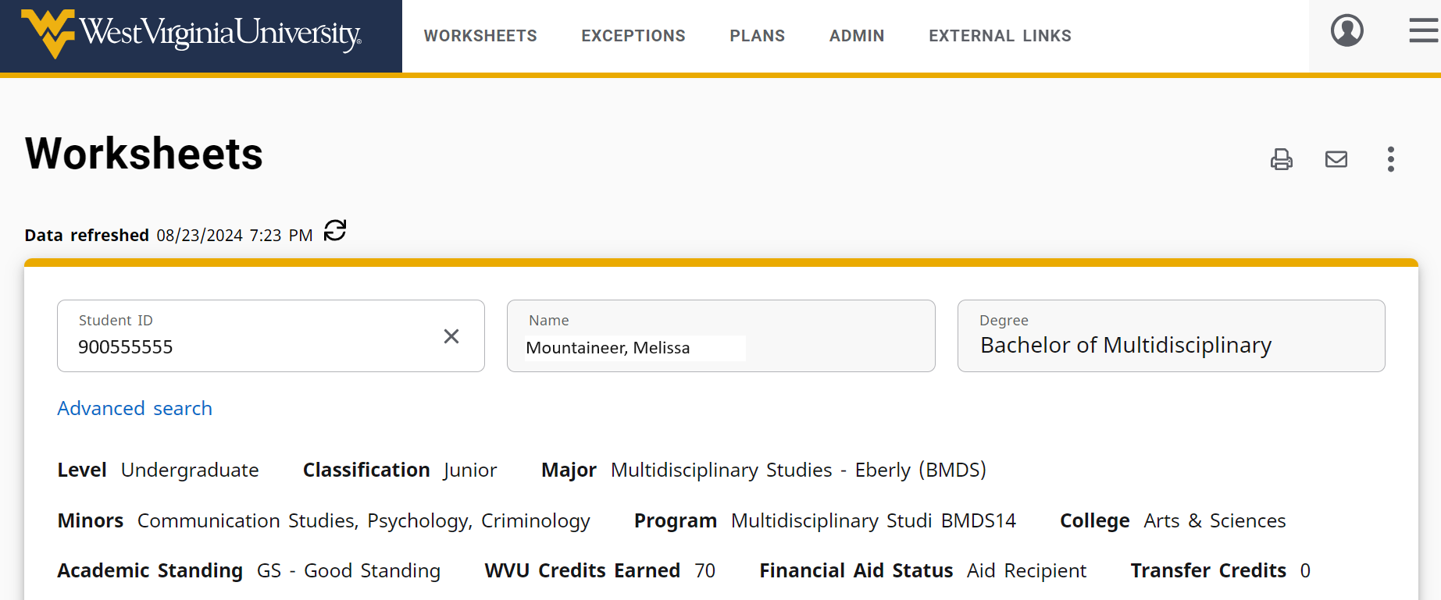
Save as PDF
Use the Print PDF feature to save or view a PDF copy of the student’s degree audit.
Version Fall 2024

Slide 22
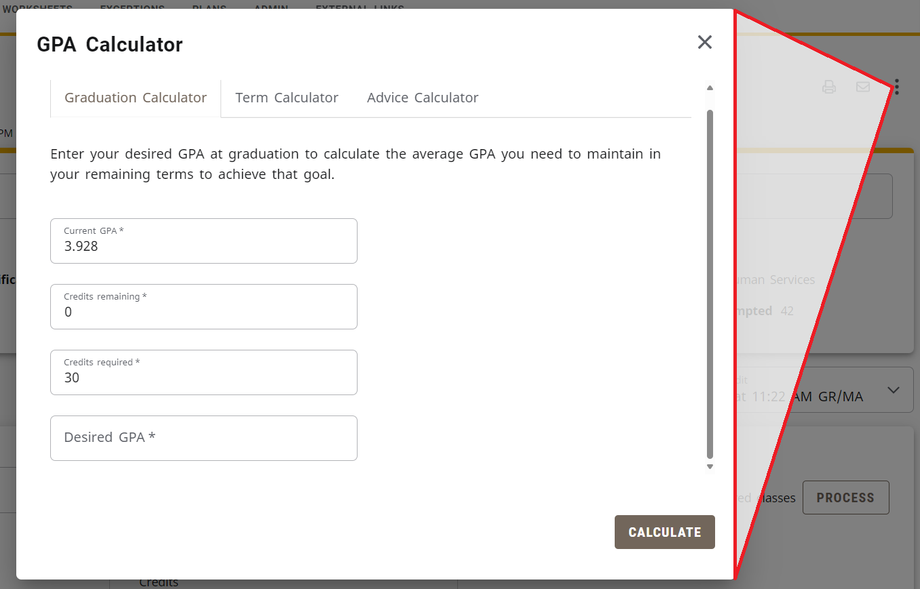
GPA Calculator
Graduation Calculator: Can a student reach his/her desired GPA in the number of credit hours remaining?
Term Calculator: How will grades achieved this term affect a student’s cumulative GPA?
Advice Calculator: How many credit hours with certain grades will achieve a desired GPA?
Version Fall 2024

Slide 23
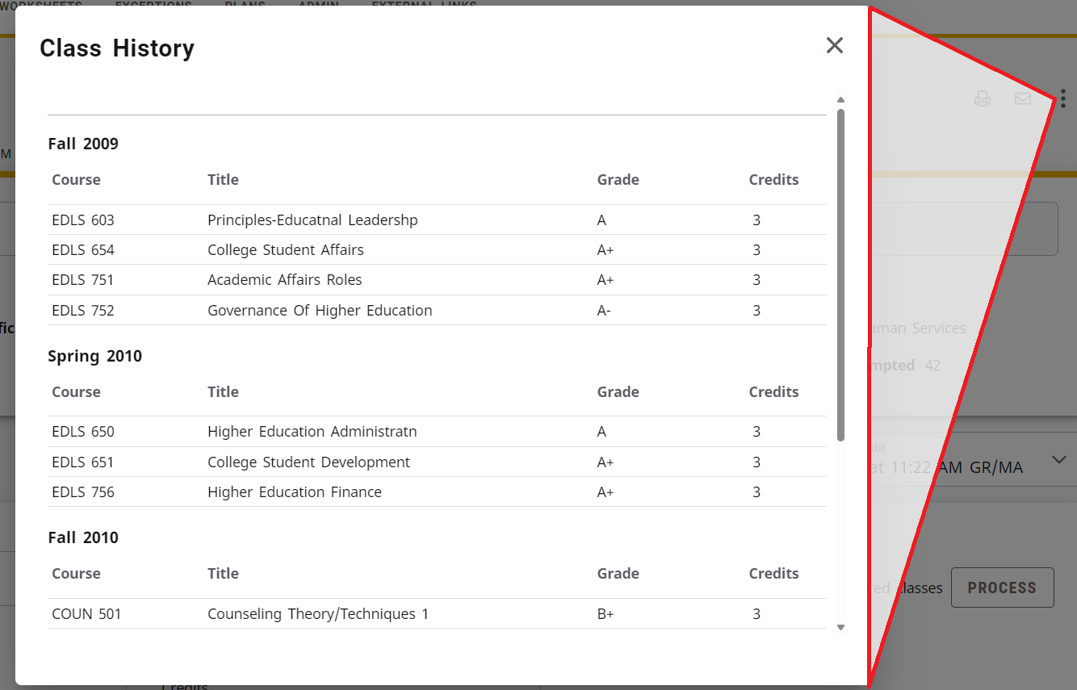
Class History
The Class History tool allows the user to view a list of classes organized by term. This shows previous coursework and classes in progress.
v6.0 Spring 2016

Slide 24
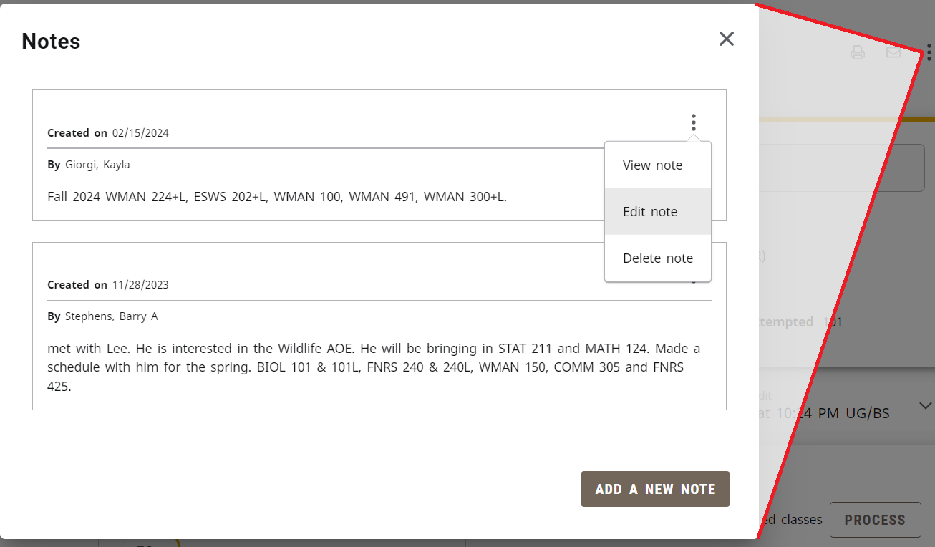
notes
The Notes feature tracks information related to a student’s degree audit or record.
You can use the Notes feature to view, edit, or delete notes
Be sure to click Process New after entering a note. This will allow the note to display at the bottom of the student’s audit.
Notes are visible to all Degree Works users including students
Version Fall 2024

Slide 25
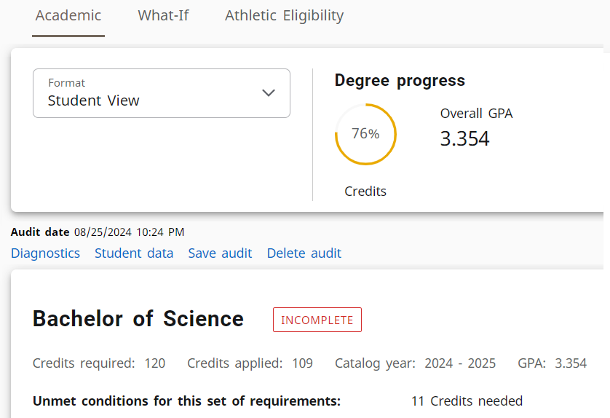
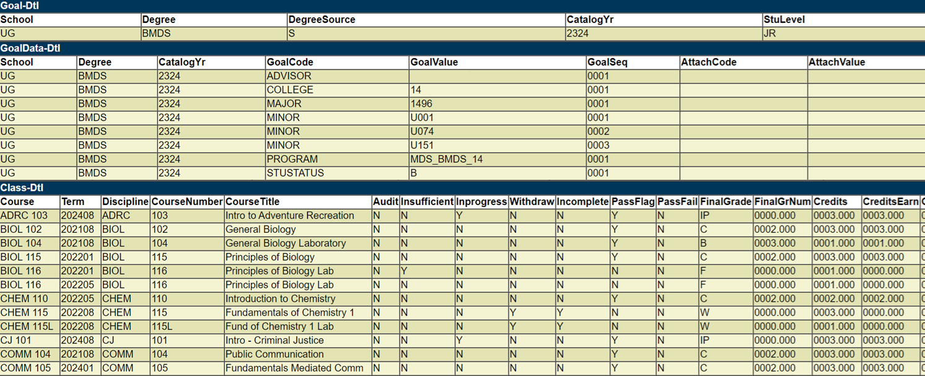
Student Data
Located immediately before the degree block, the student data link opens a new tab and allows the user to view a list of classes organized by Subject. This page also displays curricular information and course attribute details.
Version Fall 2024

Slide 26
Plans
Plans allows students and advisors to create sequenced plans of study.
The Plan List displays any existing plan. Selecting the plan description will allow for viewing/editing of the plan. To create a new plan, select ‘New plan.’
Once a plan is created, you can modify the courses and requirements. This will allow a customized plan to ensure that the plan will lead successfully to graduation.
Version Fall 2024

Slide 27
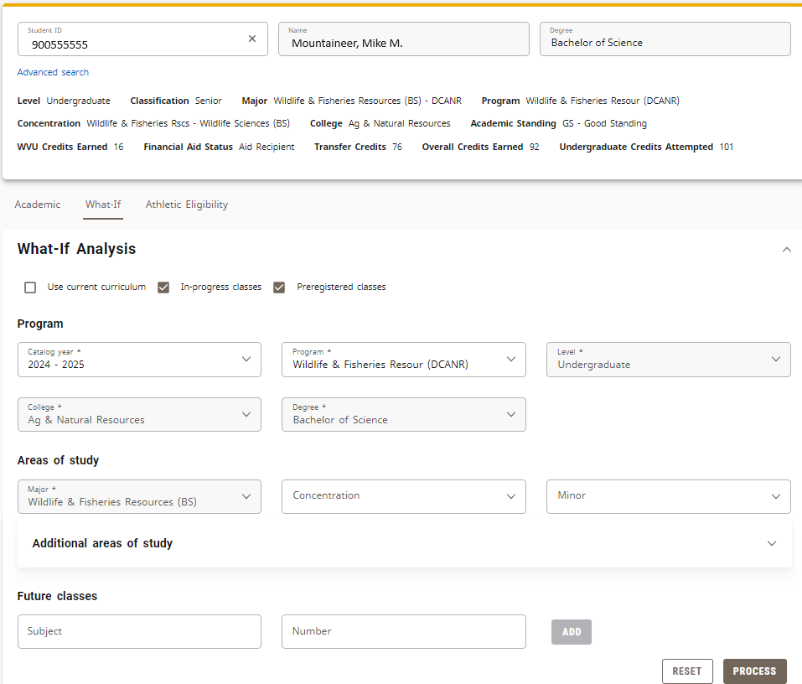
What If
Why do we use the What If feature?
To hypothesize how a change in academic program (e.g. degree, major, minor) affects previous coursework
NOTE: You must select ALL of the criteria you want to change in the audit (ie: Degree, Academic Year, Major, Minor and AoE)
Version Fall 2024

Slide 28
POSSIBLE IRREGULARITIES
Incorrect curriculum
Academic/Catalog year
Misplaced courses
Pre GEC/GEF
Missing attributes
Transfer course
No audit displayed
Pre-2008 students
Students inactive for more than semester
Dual Degree/Double Major
Toggle for second audit
Repeated Coursework
D/F Repeat
Non repeatable
Version Fall 2024

Slide 29
Contact Information:
Office of the University Registrar
Degree Works Team
304.293.5355
degreeworks@mail.wvu.edu
Version Fall 2024

